Slide 1










Finding the Balance:
Public Health and Social Measures in Zimbabwe
Partnership for Evidence-based
Response to COVID-19 (PERC)
Data updated 4 October 2021

Slide 2
PERC Overview
The Partnership for Evidence-Based Response to COVID-19 (PERC) is a public-private partnership that supports evidence-based measures to reduce the impact of COVID-19 on African Union Member States.
PERC collects social, economic, epidemiological, population movement and security data from 19 African Union Member States to help determine the acceptability, impact and effectiveness of public health and social measures for COVID-19.
This report describes findings from a telephone survey with 1,227 people conducted in September 2021, alongside local epidemiological and secondary data. The survey was approved by Medical Research Council of Zimbabwe and is the fourth report from the PERC since the pandemic began.

Slide 3
Table of Contents
Highlights
Disease Dynamics and PHSM Implementation
PSHM Support and Self-Reported Adherence
Risk Perceptions and Information
Vaccine Beliefs and Uptake
Secondary Burdens
Notes:
Situational awareness
Do people support and follow measures?
Whom do people trust?
How do people understand risk?
How do people feel about resuming activities?
What do people think about vaccines?
Are people skipping or delaying healthcare?
Are people experiencing income loss?
Are people experiencing food insecurity?

Slide 4

Highlights and Trend Analysis
Partnership for Evidence-based Response to COVID-19
Notes:
TALKING POINTS

Slide 5
Highlights
In Aug 2021, Zimbabwe experienced its third, and largest, wave of COVID-19, marked by spread to rural areas. As of 30 Aug 2021, the government began easing restrictions and promoting vaccinations through social incentives (e.g., vaccination requirements for some activities).
Since the last survey in Feb 2021, support for and self-reported adherence to individual PHSMs remained high. However, support for and adherence to measures that restrict movement, associated with higher economic burden, was comparatively low.
Perceptions of individual risk from COVID-19 infection was low, especially compared to the Southern region. Concerns for access to income and food, issues exacerbated by the pandemic, outranked concerns of the pandemic.

Slide 6
Highlights
More than 90% of respondents reported being already vaccinated for COVID-19 or planning to be vaccinated, likely associated with the various mandates for vaccination in Zimbabwe. However, there are reports of citizens opposing efforts to link vaccination to employment and social incentives.
Zimbabwe reported high reports of income loss and reduction of meals that were also the highest in the Southern Region. Reduced access to food was prevalent, largely due to increasing food prices and high levels of reported income loss. Minimal assistance from the government was offered to the population during lockdowns.

Slide 7
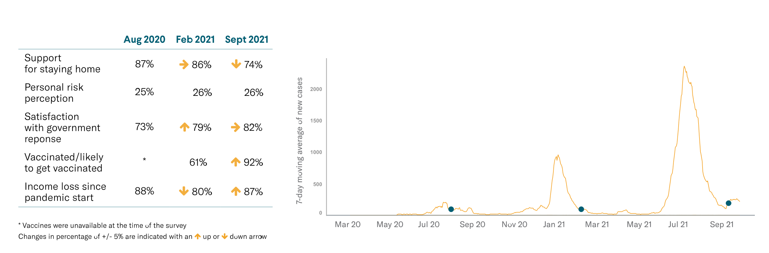
Survey Trend Highlights
Survey 2
Survey 3
Survey 4
Note: Survey 1 conducted in May 2020 is not comparable to the other three surveys because it was fielded only among urban populations, results are therefore not shown here.

Slide 8
Disease Dynamics and PHSM implementation
Partnership for Evidence-based Response to COVID-19
Notes:
TALKING POINTS

Slide 9
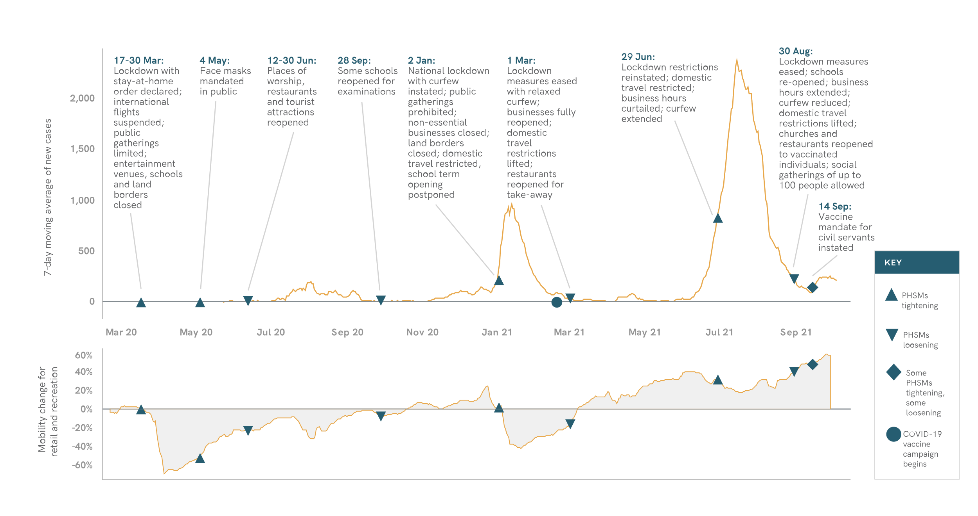
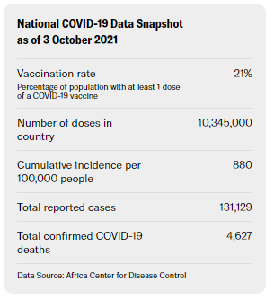
Situational Awareness
The introduction of the Delta variant and increased population mobility potentially resulted in the surge of COVID-19 cases in July.
Notes:
Starting in June 2021, Zimbabwe experienced its third and largest wave of COVID-19, which peaked on 15 July with more than 2,300 daily cases (more than double the previous peak in January 2021). Test positivity was 28% at the peak, suggesting that many cases may have gone unreported. The surge in cases was likely associated with the Delta variant, first reported in the country on 29 April, 2021.
The curfew and lockdown instated in January 2021 were eased in March after case numbers declined. PHSMs were reintroduced again in June as cases rapidly increased. The first two waves saw cases concentrated in urban centers. The third wave, however, affected rural areas as well, with several provinces designated as COVID-19 hotspots. Media reports indicate that rural residents have largely considered COVID-19 to be a “city-disease” and, as such, may not have taken the same steps to prevent transmission as urban populations.
Although Zimbabwe started vaccinations for COVID-19 in mid-February 2021, lack of reliable supply continues to impede swift rollout, a symptom of the larger problem of the patchwork supply chain of vaccines across the continent. Vaccination has been mandated for all civil servants, and for all people over the age of 14 years old who are now eligible for the COVID-19 vaccine. As of 3 Oct 2021, 10,345,000 doses have been administered across the country, and 21% of the population received at least one dose of the vaccine. Vaccine types currently available in-country include: Sinopharm, Sputnik V, Sinovac and Covaxin.
Compared to previous periods of lockdowns and movement restrictions, the mobility restrictions associated with the most recent wave did not seem to stop people from attending to regular business. The pandemic period has been marked by increased poverty across the country, likely explained by COVID-19 restrictions alongside persistent inflation, drought and other existing economic vulnerabilities.The use of health care system resources to respond to COVID-19 limited access to other essential health services, including maternal care, routine child vaccinations, and care for patients with long-standing illnesses.

Slide 10
PHSM Support and Self-Reported Adherence
Partnership for Evidence-based Response to COVID-19
Notes:
TALKING POINTS

Slide 11
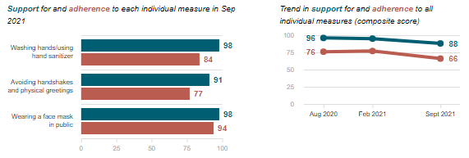
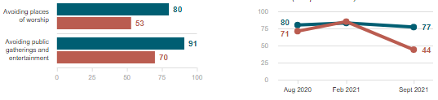
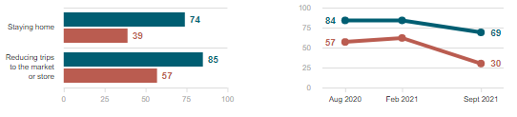
Do people support and follow measures?
Individual measures
Respondents in Zimbabwe reported slightly higher levels of support for all PHSMs compared to the other surveyed Member States in the Southern Region. However, this did not always align with adherence--overall, adherence for PHSMs declined since February 2021, aligning with the loosening of PHSMs in August 2021.
Social measures
Data Breakdown:
Respondents who expressed low satisfaction with the government response to COVID-19 also reported less support for measures restricting social gatherings and movement compared to those who were more satisfied (81% vs. 60% for social gatherings, and 74% vs.46% for movement).
Economic measures
Partnership for Evidence-based Response to COVID-19
Partnership for Evidence-based Response to COVID-19

Slide 12
Risk Perception and Information
Partnership for Evidence-based Response to COVID-19
Notes:
TALKING POINTS

Slide 13
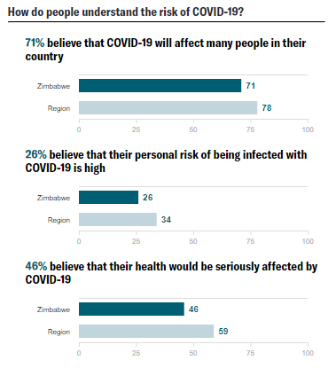
How do people understand risk?
Respondents in Zimbabwe reported the lowest indicators of risk perception across all surveyed Member States in the Southern region, when asked if COVID-19 would affect many people in the country (71% vs. 78%), if COVID-19 would affect them personally (26% vs. 34%), and if their health would be seriously affected (46% vs. 58%).
Data Breakdown:
Personal perception of risk seemed to have little influence on those who supported restrictive measures, despite the substantial decline in support across all PHSMs.
Those who reported high perceptions of risk reported lower rates of receiving or planning to receive the vaccine (30% vs. 25%).
Partnership for Evidence-based Response to COVID-19

Slide 14
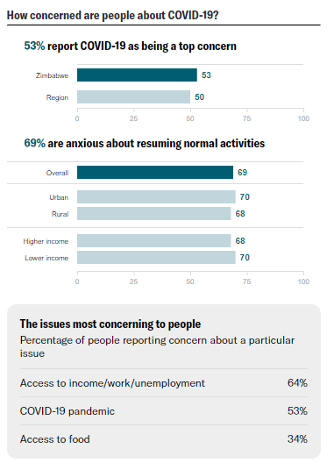
How concerned are people about COVID-19?
COVID-19 was a top concern for half of the respondents from Zimbabwe, despite low risk perception. Other prominent issues included access to income generating activities — which have been restricted by lockdowns — and access to food.
Data Breakdown:
Rural respondents ranked COVID-19 as a top concern (54%) at a higher rate than urban respondents (49%), potentially related to the novel geographic distribution of transmission during the most recent wave, which favored rural areas as opposed to previous waves, which were heavily concentrated in urban city centers.
Partnership for Evidence-based Response to COVID-19

Slide 15
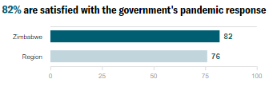
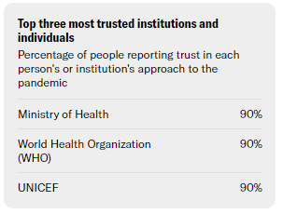
Whom do people trust?
Overall, eight out of 10 respondents reported that they were satisfied with the government’s response to COVID-19 and trusted the Ministry of Health.
Data Breakdown:
Respondents who reported low levels of satisfaction with the government’s response to COVID-19 were associated with the following attributes: being aged 18-35, living in urban areas, being highly educated, having a high income, or having missed health care visits in the past 6 months.
Adherence to restrictions on public gathering (36% vs. 45%) and movement (21% vs. 32%) was lower for respondents with low levels of satisfaction with the government’s response to the pandemic compared to those who were satisfied.
Partnership for Evidence-based Response to COVID-19

Slide 16
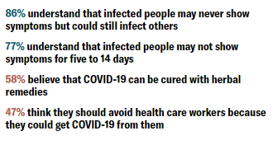
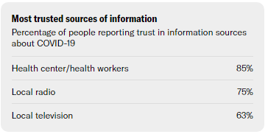
Do people believe accurate information?
Respondents in Zimbabwe generally reported high levels of belief in accurate information, including around the efficacy of mask-wearing (94%) and asymptomatic transmission (86%).
Respondents reported that traditional media — local radio and television — in addition to those affiliated with health centers were among the most trusted sources of health information.
Data Breakdown:
Social media sources were trusted by less than 25% of respondents, namely WhatsApp , followed by Facebook and Twitter.
Partnership for Evidence-based Response to COVID-19

Slide 17
Vaccine Beliefs and Uptake
The aim of these survey questions was to describe the available market for COVID-19 vaccine uptake and target populations for risk communication campaigns. As such, we report on those who likely received or will receive at least one dose of the COVID-19 vaccine, and those who are unlikely to get vaccinated. The survey does not seek to validate administrative COVID-19 vaccine coverage estimates.
Partnership for Evidence-based Response to COVID-19
Notes:
TALKING POINTS

Slide 18
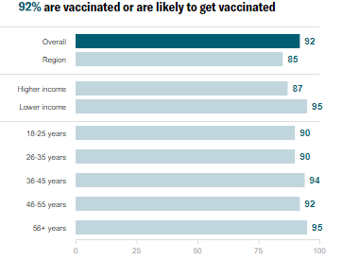
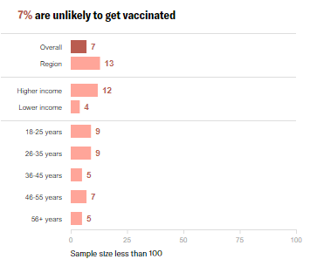
Do people want to get the COVID-19 vaccine?
Over nine in 10 respondents reported that they were either vaccinated or planning to get the COVID-19 vaccine-- greater than the Southern regional average (84%). Zimbabwe is one of the only Member States to require all civil servants to be vaccinated.
Starting in August 2021, vaccines were also required to participate in public activities, and have been deployed in Victoria Falls to boost tourism. Vaccine mandates have now entered the private sector, prompting strong pushback given the difficulty in acquiring a vaccine and the threat to livelihoods caused by widespread income loss.
Partnership for Evidence-based Response to COVID-19

Slide 19
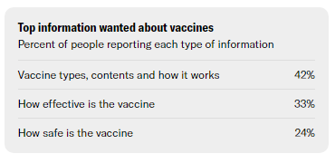
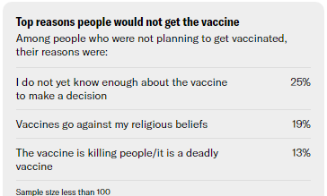
What do people think about COVID-19 vaccines?
Not having enough information was the most frequent reason cited by respondents for why they would not get the vaccine; all respondents indicated a need for more information on vaccine types, safety and effectiveness. Widely trusted and used sources of information — including local radio and local television — should be used for community engagement and information campaigns.
Partnership for Evidence-based Response to COVID-19

Slide 20
Secondary Burdens
Partnership for Evidence-based Response to COVID-19
Notes:
TALKING POINTS

Slide 21
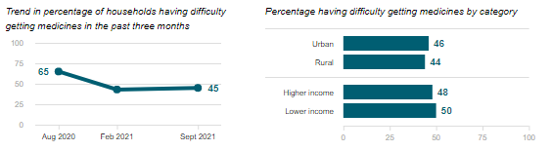
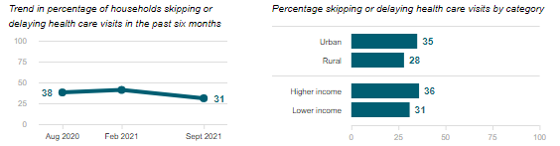
Are people skipping or delaying healthcare?
Difficulty getting medicines
Among respondents reporting they or someone in their household needed health care, one-third reported skipping or delayed services in the previous six months. Almost half (45%) of respondents reported difficulty acquiring medicine, a drop from 65% in August 2020.
Skipping or delaying health visits
Data Breakdown:
In addition to urban and higher-income respondents, a larger share of households that have lost all of their income (43%) and people with longstanding illnesses (37%) reported difficulty accessing health care--similar trends seen across the Southern region.
Partnership for Evidence-based Response to COVID-19

Slide 22
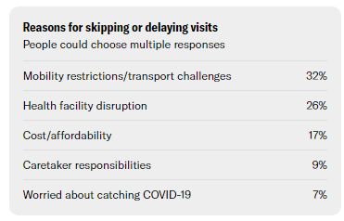
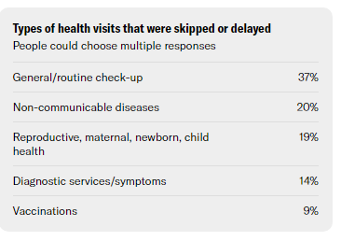
Are people skipping or delaying healthcare?
The most commonly cited reasons respondents gave for skipping or delaying a health visit were related to capacity of facilities and restrictions, including mobility restrictions/transport challenges (32%), health facility disruption (26%) and affordability (17%).
Approximately one in five missed visits were for maternal and child care. Media reports indicate that pregnant women in rural areas are particularly affected by limited access to health care, and during the pandemic there has been an increase in home deliveries, stillbirths and maternal mortality.
Partnership for Evidence-based Response to COVID-19

Slide 23
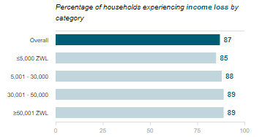
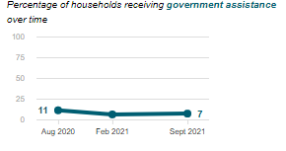
Are people experiencing income loss?
Almost nine out of ten respondents from Zimbabwe reported loss of income, the highest in the Southern Region. COVID-19 strained Zimbabwe’s already fragile economy. One out of every two people in Zimbabwe is now considered to be extremely poor.
Data Breakdown:
Respondents older than 56 or those with lower education most frequently reported losing substantial amounts of income.
A very small number of respondents reported receiving government assistance (7%). Challenges reported in the media included incomplete registrars, while internationally-supported cash transfers programs were often not national, or had very specific targeting criteria.
Partnership for Evidence-based Response to COVID-19

Slide 24
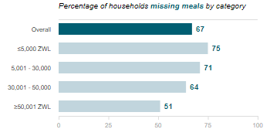
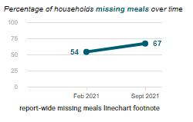
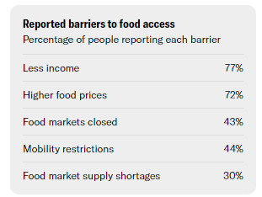
Are people experiencing food insecurity?
A combination of drought, income loss and inflation created an enabling environment for increased food prices. Two out of three respondents reported reducing their number of meals in a day, a trend that has increased since February 2021 and is highest among those surveyed in the Southern Region.
Data Breakdown:
Even respondents who reported minimal to no income loss reported challenges in accessing food. Compared to 67% of all respondents that missed meals, 32% of respondents with no reported income loss since the start of the pandemic also reported missing meals.
In addition to rising food prices as a result of COVID-19, Zimbabwe’s local currency is experiencing instability and inflation, which could further threaten the ability to purchase food and increase perceptions of income loss in Zimbabwe.
Partnership for Evidence-based Response to COVID-19

