Slide 1










Finding the Balance:
Public Health and Social Measures in Tunisia
Partnership for Evidence-based
Response to COVID-19 (PERC)
Data updated 3 October 2021

Slide 2
PERC Overview
The Partnership for Evidence-Based Response to COVID-19 (PERC) is a public-private partnership that supports evidence-based measures to reduce the impact of COVID-19 on African Union Member States.
PERC collects social, economic, epidemiological, population movement and security data from 19 African Union Member States to help determine the acceptability, impact and effectiveness of public health and social measures for COVID-19.
This report describes findings from a telephone survey with 1,197 people conducted in September 2021, alongside local epidemiological and secondary data. The survey was approved by Tunisian Ministry of Health, Primary Healthcare Administration and is the fourth report from the PERC since the pandemic began.

Slide 3
Table of Contents
Highlights
Disease Dynamics and PHSM Implementation
PSHM Support and Self-Reported Adherence
Risk Perceptions and Information
Vaccine Beliefs and Uptake
Secondary Burdens
Notes:
Situational awareness
Do people support and follow measures?
Whom do people trust?
How do people understand risk?
How do people feel about resuming activities?
What do people think about vaccines?
Are people skipping or delaying healthcare?
Are people experiencing income loss?
Are people experiencing food insecurity?

Slide 4

Highlights and Trend Analysis
Partnership for Evidence-based Response to COVID-19
Notes:
TALKING POINTS

Slide 5
Highlights
Tunisia's largest wave of COVID-19 cases spiked in July '21, causing the health care system to collapse. Civil unrest has worsened since the beginning of the pandemic, particularly related to rising unemployment rates due to restrictive measures, leading to the president claiming executive powers in July. ​
Support for measures restricting public gatherings and movement — both associated with loss of income — declined since Feb '21, corresponding with increased protests and resistance against restrictions impacting economic growth. ​
Personal risk perceptions and concerns about COVID-19 were lower compared to the Northern Africa regional average. While unemployment ranked as a top concern, support for the government, and the president in particular, increased substantially since Feb '21. ​
Nine in 10 were either vaccinated or likely to get vaccinated — a substantial increase from 35% of respondents in Feb '21.
~50% of those who needed health care in the last six months reported skipping or delaying visits. 3/4 experienced income loss since the start of the pandemic, and ~50% reported having to miss a meal in the previous week.

Slide 6
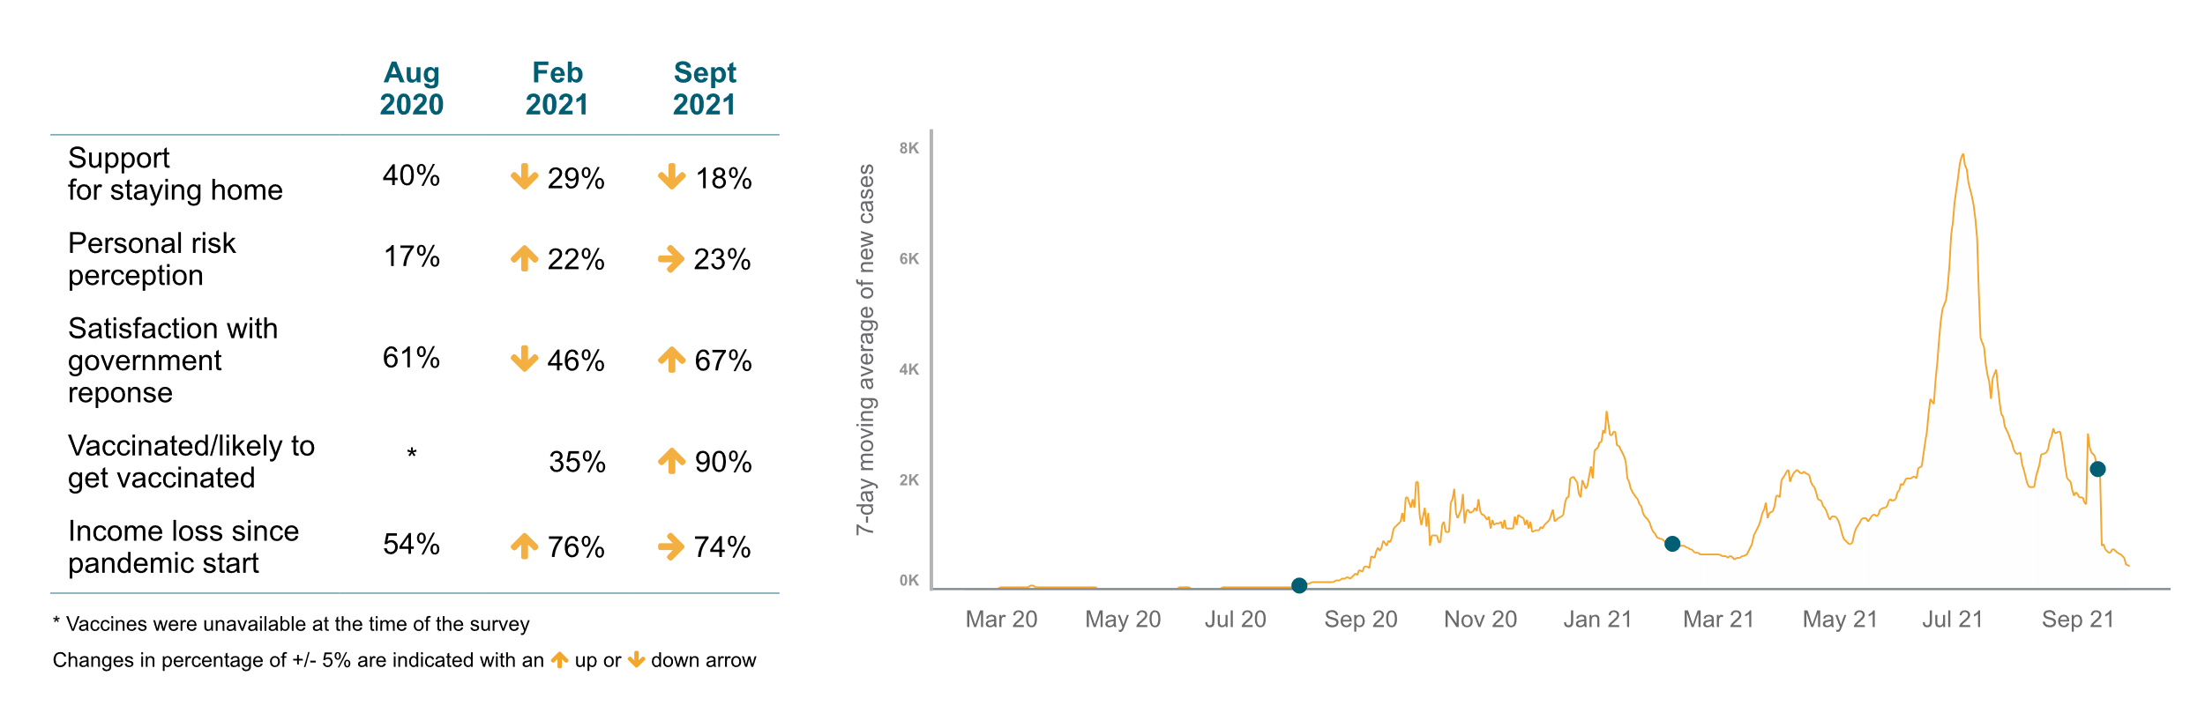
Survey Trend Highlights
Restrictive measures put in place to curb the succession of large waves of COVID-19 cases in Tunisia have compounded income loss, leading to a steady drop in support for PHSMs and wavering satisfaction with the government.
Survey 2
Survey 3
Survey 4
Note: Survey 1 conducted in May 2020 is not comparable to the other three surveys because it was fielded only among urban populations, results are therefore not shown here.

Slide 7
Disease Dynamics and PHSM implementation
Partnership for Evidence-based Response to COVID-19
Notes:
TALKING POINTS

Slide 8
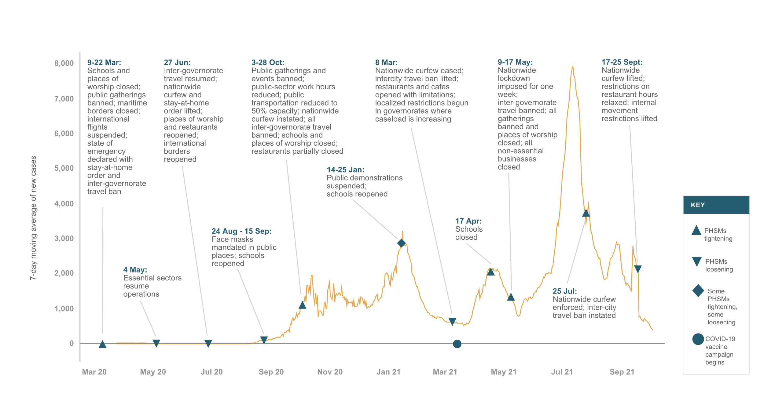
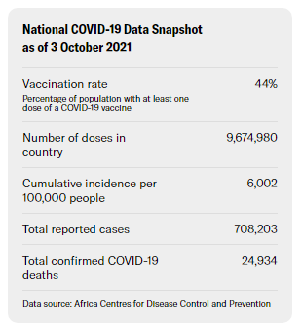
Situational Awareness
After Tunisia experienced its worst wave of COVID-19 cases, the president invoked emergency powers to take over the COVID-19 response; the majority of PHSMs were lifted in September as cases began to decrease.
Notes:
In the previous six months, Tunisia experienced three waves of COVID-19 cases in April, July and August 2021, likely due to the Delta variant. The July wave was the largest, with 7,800 new cases reported per day; the August wave followed with only 2,900 new cases per day. At the height of the July wave, reports showed that the health system collapsed, with health facilities and ICU beds beyond capacity. Test positivity reached almost 30% at the peak for each wave, suggesting that many cases and deaths went undetected.
As of September 2021, Tunisia has been implementing PHSMs by governorate, based on COVID-19 caseload. Governorates experiencing infection rates exceeding 200 cases per 100,000 inhabitants must abide by an inter-governorate travel ban, a nightly curfew and a ban on all large gatherings. During the fielding of this survey, President Kais Saied loosened the majority of nationwide restrictions; as of October 2021, the only restrictions that remained in place were capacity limits on most establishments and a vaccination requirement to attend public gatherings.
On 13 Mar 2021 the Tunisian government began a COVID-19 vaccination campaign. As of mid-October, 44% of the population had received the first dose of a vaccine. Tunisia is using seven types of vaccines: AstraZeneca, Sinopharm, Sputnik V, Pfizer/BioNTech, Johnson & Johnson, Sinovac and Moderna.
Protests and unrest, particularly among younger people, have increased significantly since the beginning of the pandemic due to increasing dissatisfaction with the government’s response to COVID-19 and rising unemployment resulting from COVID-19 and accompanying PHSMs. At the height of the July wave, President Saied ordered the military to take over the pandemic response after the health minister was fired for opening vaccination centers during a religious holiday. Then on 25 Jul, Saied invoked emergency powers and suspended Parliament to address the economic and COVID-19 situation in the country. This was met with mixed reactions, with the opposition increasing their calls for Saied’s resignation. In September, the president named a new prime minister tasked with setting up a new government.

Slide 9
PHSM Support and Self-Reported Adherence
Partnership for Evidence-based Response to COVID-19
Notes:
TALKING POINTS

Slide 10
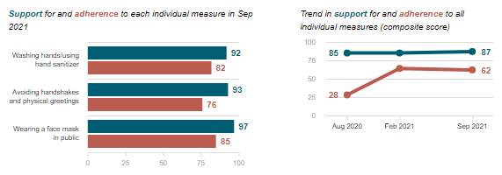
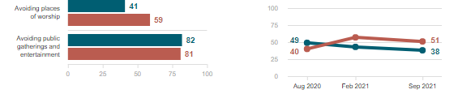
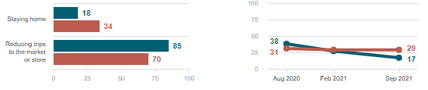
Individual measures
Do people support and follow measures?
While support for individual PHSMs remains high in Tunisia, only approximately half of respondents supported measures that restrict public gatherings and a quarter supported measures that restrict movement. Support for measures that restrict public gatherings and movement both declined since February 2021, corresponding with the increased protests and resistance against restrictions that have impeded economic growth.
Social measures
Data Breakdown:
Those who reported higher trust in the president reported higher adherence to all individual measures (63% vs. 47%), gathering restrictions (52% vs. 42%) and movement restrictions (29% vs. 20%).
Economic measures
Partnership for Evidence-based Response to COVID-19

Slide 11
Risk Perception and Information
Partnership for Evidence-based Response to COVID-19
Notes:
TALKING POINTS

Slide 12
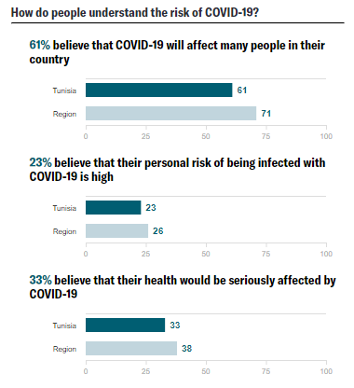
How do people understand risk?
Perceptions of personal COVID-19 risk were below the regional average; only a quarter of respondents felt they were at risk of contracting the disease and one-third believed their health would be seriously affected if infected. Low risk perception could be of concern considering the high infection rates in Tunisia and the deleterious impact the July COVID-19 wave had on the health care system, but could also be explained by high vaccination rates.
Data Breakdown:
Of those reporting high perception of severity of illness, 35% stated they have gotten, or would likely get vaccinated versus only 22% who stated they were unlikely to get vaccinated. Those with high perceived risk of COVID-19 infection were no more or less likely to get vaccinated.

Slide 13
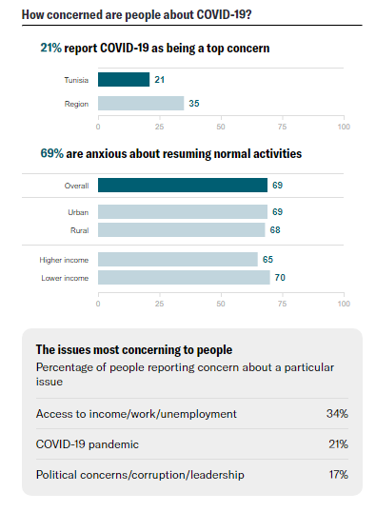
How concerned are people about COVID-19?
Concern about COVID-19 was low among respondents in Tunisia, particularly when compared to other surveyed Member States in the Northern region. COVID-19 was a top concern for only one in five survey respondents; the regional average was one in three. The alarming rates of income loss experienced across Tunisia are also reflected in the survey results. In line with the decline in support for economically restrictive PHSMs, access to income was the most concerning issue to respondents from Tunisia.
Data Breakdown:
Access to income was more concerning for young people; 36% of respondents under the age of 45 reported unemployment as a top concern, compared to 29% of respondents 46 and older.

Slide 14
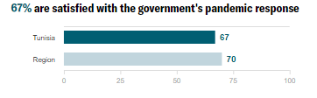
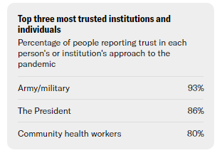
Whom do people trust?
Two-thirds of respondents were satisfied with the government’s response to the COVID-19 pandemic, an increase of 21 percentage points since the February 2021 survey; furthermore, there was a 24 point increase in trust in the president. These substantial boosts occurred after the president invoked emergency powers in July to “follow the people” and take over the COVID-19 response from Parliament.
Data Breakdown:
The military has remained the most trusted institution for the COVID-19 response, increasing by 10 percentage points from February 2021. Historically, the Tunisian military has been considered apolitical with broad public support. At the height of the July 2021 COVID-19 surge, the president requested the military to take over management of the national pandemic response.

Slide 15
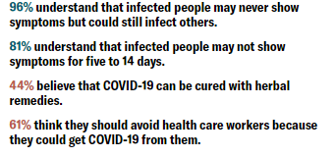
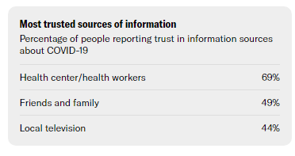
Do people believe accurate information?
Although accurate understanding of COVID-19 transmission dynamics remains widespread in Tunisia, belief in misinformation — such as believing herbal remedies can cure COVID-19 — and narratives that may lead to stigmatization — particularly against health care workers and those who have recovered from COVID-19 — were also high, with minimal change from the February 2021 survey. Trusted sources of information in Tunisia — including health facilities and local television — could be valuable channels to address misinformation, rumors and stigmatizing messages.

Slide 16
Vaccine Beliefs and Uptake
The aim of these survey questions was to describe the available market for COVID-19 vaccine uptake and target populations for risk communication campaigns. As such, we report on those who likely received or will receive at least one dose of the COVID-19 vaccine, and those who are unlikely to get vaccinated. The survey does not seek to validate administrative COVID-19 vaccine coverage estimates.
Partnership for Evidence-based Response to COVID-19
Notes:
TALKING POINTS

Slide 17
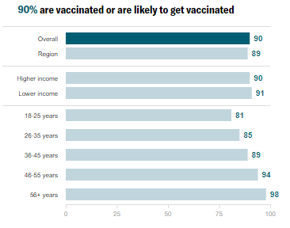
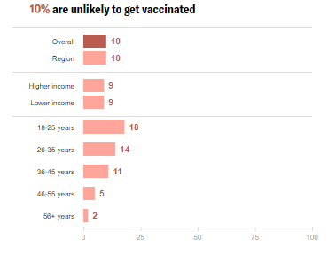
Do people want to get the COVID-19 vaccine?
Nine out of 10 respondents in Tunisia reported that they were either vaccinated or likely to get the COVID-19 vaccine, a substantial increase from February 2021 (35%). The increase in the likelihood to get vaccinated is likely due to the rapid rollout of vaccine campaigns throughout the Member State.
Data Breakdown:
The dramatic increase in support for the government and the president may be playing a role — a larger share of those who were likely to get vaccinated, compared to those unlikely, expressed support for the government’s pandemic response and trusted the president (69% vs. 51% and 87% vs. 73%, respectively).

Slide 18
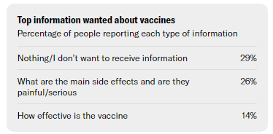
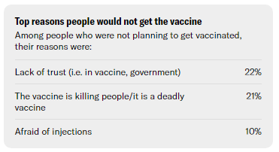
What do people think about COVID-19 vaccines?
More information on side effects of the COVID-19 vaccine was the most needed among all respondents. The specific information concerns and needs of more vaccine-hesitant groups — particularly younger people — should be addressed through targeted messaging and community engagement strategies, using trusted sources such as health workers and local television.
Data Breakdown:
The remaining 10% of respondents unlikely to get vaccinated may be a difficult subset to target messaging to. That group reported higher rates of not needing any additional information on the vaccine (37%, vs. 28% of those likely to get vaccinated); they also reported a lack of trust in the vaccine and government, concerns that the vaccine is deadly, and a general fear of injections.

Slide 19
Secondary Burdens
Partnership for Evidence-based Response to COVID-19
Notes:
TALKING POINTS

Slide 20
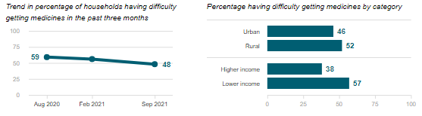
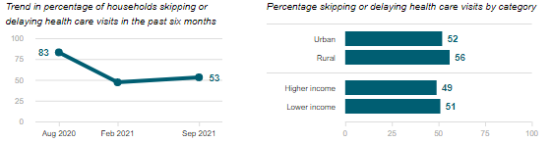
Are people skipping or delaying healthcare?
Difficulty getting medicines
In Tunisia, over half of respondents who needed health care in the last six months reported skipping or delaying visits, the highest rate of all surveyed Member States and an increase since February 2021 (53% vs. 47%). About half of respondents reported difficulties accessing needed medication.
Skipping or delaying health visits
Data Breakdown:
In addition to rural and lower-income respondents, respondents over the age of 46 (54% vs. 44%), those in the lowest income group (57% vs. 38%) and those with long-standing illnesses (57% vs. 44%) also reported more difficulty in accessing medicine.

Slide 21
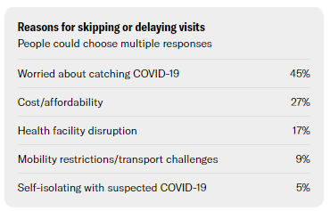
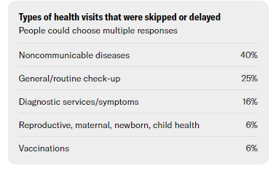
Are people skipping or delaying healthcare?
In line with findings from February 2021, almost half of those who missed or skipped a health care visit did so due to concerns about catching COVID-19. This could be due to the increased caseload in recent waves, as well as the increased burden on the Tunisian health care system during each successive surge.
Data Breakdown:
Among respondents who skipped care, four in 10 stated it was for noncommunicable diseases, with cardiovascular issues and diabetes most commonly reported. According to WHO, half of total mortality in Tunisia is due to cardiovascular diseases, with diabetes also in the top ten causes of mortality.

Slide 22
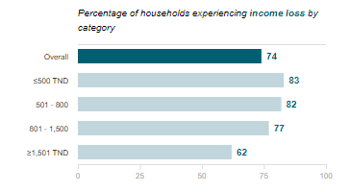
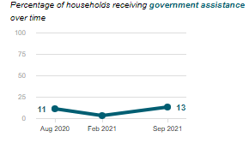
Are people experiencing income loss?
Three-quarters of respondents reported experiencing income loss since the start of the pandemic; unemployment has also risen from 15% to 18% by June 2021. Many blame restrictive COVID-19 mitigation measures for this substantial rise in unemployment.
Data Breakdown:
While initial reports showed that unemployment primarily affected young people under 24 years old and women, the September 2021 survey showed that income loss has become more widespread across all ages.
Income loss was also reported by more rural households (80% vs. 72% of urban) and less-educated households (78% of those who completed secondary degrees or under, vs. 63% with university or post-graduate degrees).

Slide 23
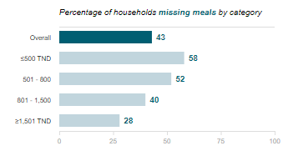
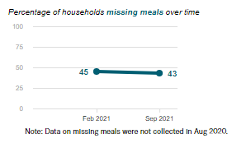
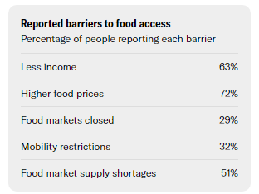
Are people experiencing food insecurity?
More than four in 10 respondents reported having to reduce the number of meals they consumed in the previous week. Lost income was among the most commonly cited barriers to food access, along with high food prices.
Data Breakdown:
Lower-income respondents reported missing meals and income loss at higher rates than did higher-income respondents.

