Slide 1










Finding the Balance:
Public Health and Social Measures in Morocco
Partnership for Evidence-based
Response to COVID-19 (PERC)
Data updated 1 October 2021

Slide 2
PERC Overview
The Partnership for Evidence-Based Response to COVID-19 (PERC) is a public-private partnership that supports evidence-based measures to reduce the impact of COVID-19 on African Union Member States.
PERC collects social, economic, epidemiological, population movement, and security data from 19 African Union Member States to help determine the acceptability, impact and effectiveness of public health and social measures for COVID-19.
This report describes findings from a telephone survey with 1,244 people conducted in September 2021, alongside local epidemiological and secondary data. The survey is the second report from the PERC since the pandemic began.

Slide 3
Table of Contents
Highlights
Disease Dynamics and PHSM Implementation
PSHM Support and Self-Reported Adherence
Risk Perceptions and Information
Vaccine Beliefs and Uptake
Secondary Burdens
Notes:
Situational awareness
Do people support and follow measures?
Whom do people trust?
How do people understand risk?
How do people feel about resuming activities?
What do people think about vaccines?
Are people skipping or delaying healthcare?
Are people experiencing income loss?
Are people experiencing food insecurity?

Slide 4

Highlights and Trend Analysis
Partnership for Evidence-based Response to COVID-19
Notes:
TALKING POINTS

Slide 5
Highlights
Morocco experienced its second and most severe wave of COVID-19 in August 2021, which has since begun to taper off. A state of emergency has been in place in Morocco since the start of the pandemic in March 2020, and dynamic implementation of PHSMs based on epidemiological need has helped to reduce transmission.
While support for and self-reported adherence to individual measures remained high and unchanged since February 2021, support for measures restricting social gatherings and movement was much lower.
Although personal risk perception was low (similar to findings from February 2021), respondents showed above-average country risk perception and high levels of agreement that COVID-19 was a top concern in Morocco. Access to income and employment, however, eclipsed COVID-19 as the most pressing concern among respondents.
There was near-universal support for vaccination among respondents, with nine in 10 having already been vaccinated or likely to get vaccinated for COVID-19, the highest rate among all surveyed Member States.
Income loss continues to be a persistent problem in Morocco, with nearly nine in 10 households reporting losing some or all of their income since the start of the pandemic (higher than the Northern regional average). Negative economic conditions are also affecting access to food, with three-quarters of respondents reporting difficulty accessing food due to income loss.

Slide 6
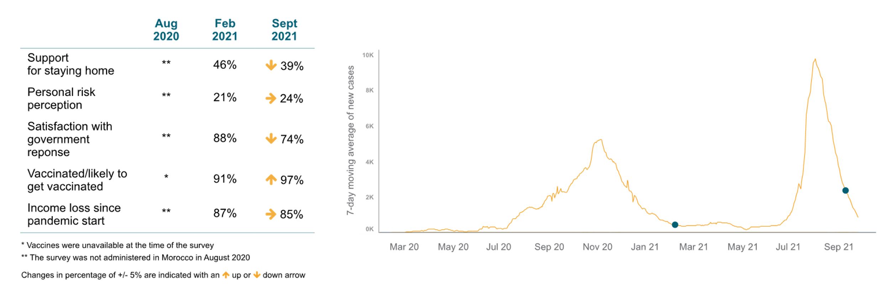
Survey Trend Highlights
Pandemic-related unemployment is contributing to ongoing income loss in Morocco; high vaccine acceptance and uptake may be key in controlling COVID-19 and boosting the economy.
Survey 1
Survey 2

Slide 7
Disease Dynamics and PHSM implementation
Partnership for Evidence-based Response to COVID-19
Notes:
TALKING POINTS

Slide 8
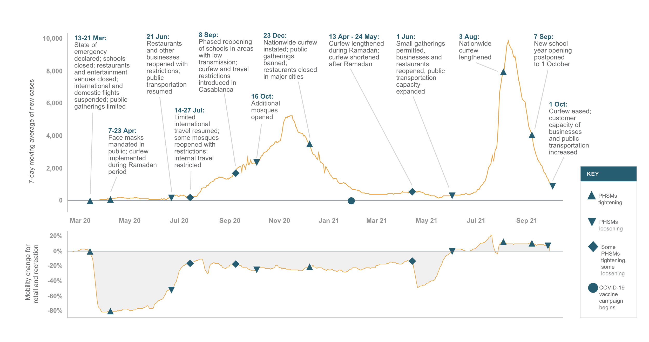
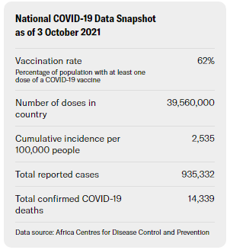
Situational Awareness
The Delta variant and increased population mobility potentially contributed to the surge of COVID-19 cases in August, despite high vaccination rates.
Notes:
The second and most severe wave of COVID-19 transmission began in Morocco in mid-July 2021, peaking in August with nearly 10,000 new cases per day (almost twice the peak of the previous wave in November 2020). Test positivity reached 24% in August 2021, and remained above 10% until the end of September, suggesting many cases may have gone undetected. In August, hospital ICUs were reaching capacity and health workers warned of oxygen shortages. The Delta variant, combined with increased mobility and relaxation of many restrictions, likely contributed to this surge.
Morocco has been in a prolonged state of health emergency since the beginning of the pandemic in March 2020; associated PHSMs have been applied dynamically as epidemiological need indicated. When new cases were low in June 2021, for example, lockdown measures were eased, the nationwide curfew was shortened and tourists were permitted to enter conditionally; once cases were nearing peak levels in August, however, the curfew was extended and travel restrictions were implemented for unvaccinated tourists. Measures that currently remain in place include a shortened nightly curfew, capacity limits on restaurants and businesses, and mandatory vaccination to enter public spaces.
Morocco began COVID-19 vaccinations in January 2021, initially using Sinopharm and AstraZeneca vaccines; the Johnson & Johnson and Pfizer/BioNTech vaccines have since been included in the campaign as well. By the end of September, nearly 65% of the population had been vaccinated with at least one dose in Morocco, the highest percentage across Africa, and far beyond the WHO goal of 10%. Morocco has expanded vaccine eligibility to those aged 12 and older and has made plans to provide a booster dose to vulnerable and at-risk groups. In October, after this survey was fielded, officials in Morocco introduced a digital vaccine pass to validate immunity status, which is now required to access businesses, restaurants and public transportation. Protests recently broke out across the country in response to this mandate.
Parliamentary elections were held in September 2021, resulting in the abrupt transfer of power from the Islamist Justice and Development Party (PJD) — which has ruled since 2011 — to the National Rally of Independents (RNI). The PJD faced heavy criticism for failing to deliver on many promises made over the past decade, particularly those related to improving the economy, which was further damaged by COVID-19. The RNI is expected to be more aligned with the agenda of the king, which includes new policies to increase national health care coverage, as well as reduce unemployment and inequality.

Slide 9
PHSM Support and Self-Reported Adherence
Partnership for Evidence-based Response to COVID-19
Notes:
TALKING POINTS

Slide 10
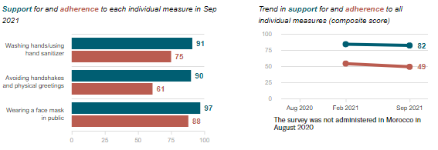
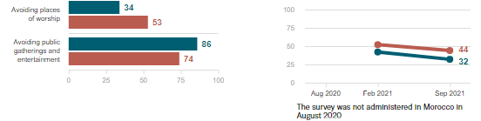
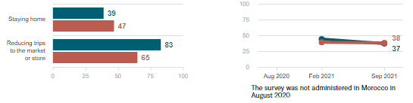
Individual measures
Do people support and follow measures?
Individual PHSMs commanded high support and adherence among respondents, unchanged since February 2021 and on par with the Northern regional averages. In contrast, support for measures restricting social gatherings and movement decreased by seven and 10 percentage points, respectively. Support for measures restricting social gatherings was well below the Northern regional average (32% vs. 43%).
Social measures
Data Breakdown:
High personal risk perception was associated with greater reported adherence to all measures, including avoiding places of worship (64% vs. 44%) and public gatherings (82% vs. 70%), compared to low personal risk perception.
Economic measures
Partnership for Evidence-based Response to COVID-19
Partnership for Evidence-based Response to COVID-19

Slide 11
Risk Perception and Information
Partnership for Evidence-based Response to COVID-19
Notes:
TALKING POINTS

Slide 12
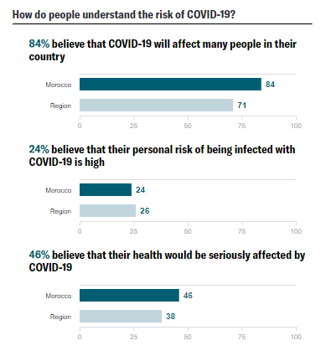
How do people understand risk?
Only one-quarter of respondents felt they were personally at high risk of catching COVID-19, on par with findings from February 2021 and the Northern regional average. By contrast, more than four in five respondents felt that the virus posed a threat to their country, far higher than the Northern regional average (71%).
Data Breakdown:
Almost half of respondents believed that, if infected with COVID-19, their health would be seriously affected, higher than the regional average (38%).
Partnership for Evidence-based Response to COVID-19

Slide 13
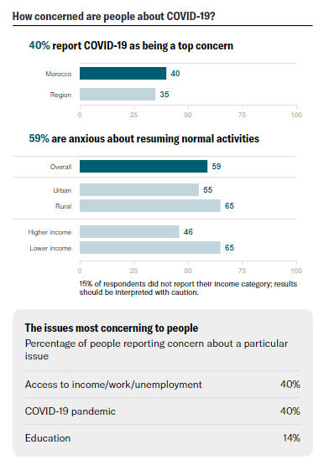
How concerned are people about COVID-19?
COVID-19 was ranked a top concern by two in five respondents. In addition to the COVID-19 pandemic, access to income and employment was one of the top concerns cited by respondents in Morocco; particularly by rural compared to urban respondents (46% vs. 36%).
Data Breakdown:
Female respondents reported education as a top concern at higher rates than male respondents (20% vs. 8%). School closures related to COVID-19 have had disproportionate effects on women globally, and that has been the case in Morocco
Partnership for Evidence-based Response to COVID-19

Slide 14
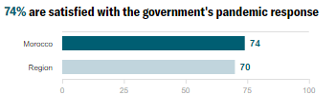
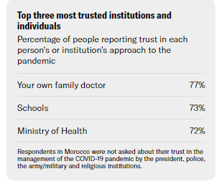
Whom do people trust?
Health-related individuals and institutions remain some of the most trusted to manage the COVID-19 response among respondents in Morocco, similar to results from February 2021. Satisfaction with the government’s response to COVID-19 decreased since February 2021 (74% vs. 88%). The decline in satisfaction with the government likely reflected opinions about the PJD’s COVID-19 response, as the new ruling party had not yet taken office since the Parliamentary elections in September.
Data Breakdown:
Since February 2021, substantial support for the government has been lost among young people aged 18-25 (51% vs. 74%) and 26-35 (61% vs. 85%).
Partnership for Evidence-based Response to COVID-19

Slide 15
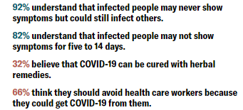
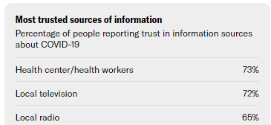
Do people believe accurate information?
Local information sources — including health workers, television, radio, and family and friends — were the most trusted for information about the COVID-19 pandemic in Morocco.
Respondents in Morocco demonstrated widespread understanding of accurate information about the importance of washing hands (94%) and wearing a face mask (89%) to prevent disease transmission. However, respondents also demonstrated some of the highest levels of belief in statements that may lead to the stigmatization of health care workers (66%) and people who have recently recovered from COVID-19 (72%) among all surveyed Member States
Partnership for Evidence-based Response to COVID-19

Slide 16
Vaccine Beliefs and Uptake
The aim of these survey questions was to describe the available market for COVID-19 vaccine uptake and target populations for risk communication campaigns. As such, we report on those who likely received or will receive at least one dose of the COVID-19 vaccine, and those who are unlikely to get vaccinated. The survey does not seek to validate administrative COVID-19 vaccine coverage estimates.
Partnership for Evidence-based Response to COVID-19
Notes:
TALKING POINTS

Slide 17
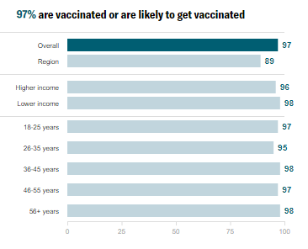
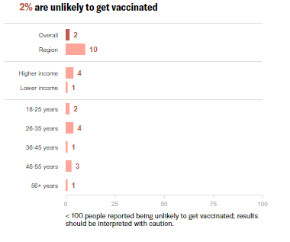
Do people want to get the COVID-19 vaccine?
Morocco is one of the few AU Member States to surpass the WHO goal of vaccinating 10% of the population by the end of September 2021. Respondents across all demographic groups reported almost universal vaccine acceptance (97%), the highest among surveyed Member States, and consistent with officially reported rates of vaccine administration in Morocco, which are the highest in Africa.
Partnership for Evidence-based Response to COVID-19

Slide 18
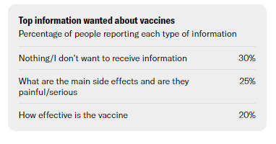
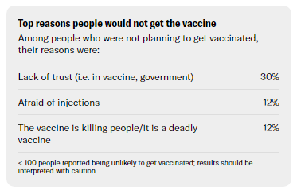
What do people think about COVID-19 vaccines?
The most common response given when asked what information respondents wanted to know about the COVID-19 vaccine in Morocco was “Nothing.” The overwhelming majority (97%) of respondents in Morocco either were vaccinated or likely to get vaccinated, suggesting the population is overall well-informed about the vaccine.
Data Breakdown:
Despite survey results indicating very high vaccine acceptance, a recent government initiative (launched in October 2021, after the fielding of this survey) to require proof of vaccination to access public spaces has received some backlash, and small-scale protests erupted across a handful of cities. Critics primarily voiced concern over the speedy implementation timeline rather than the measure itself.
Partnership for Evidence-based Response to COVID-19

Slide 19
Secondary Burdens
Partnership for Evidence-based Response to COVID-19
Notes:
TALKING POINTS

Slide 20
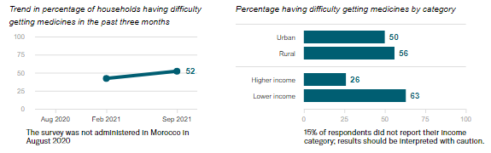
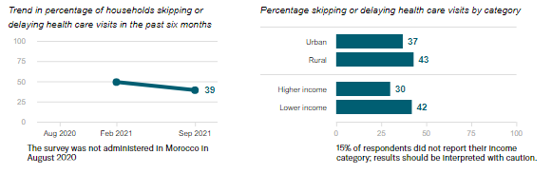
Are people skipping or delaying healthcare?
Difficulty getting medicines
Among respondents reporting they or someone in their household needed health care or medication, about two in five skipped or delayed services in the past six months, and just over half reported difficulty accessing medication in the past 3 months. While missed visits have decreased since February 2021 (49% vs. 39%), difficulty accessing medication has increased (42% vs. 52%).
Skipping or delaying health visits
Data Breakdown:
Disruptions in access to medicine disproportionately affected lower-income respondents. Respondents with longstanding illnesses also reported greater difficulty accessing medication compared to those who did not (60% vs. 46%).
Partnership for Evidence-based Response to COVID-19

Slide 21
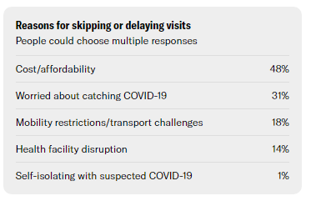
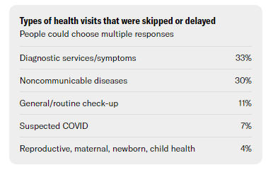
Are people skipping or delaying healthcare?
Cost was a barrier to accessing needed medical care among half of respondents, particularly among lower-income respondents compared to higher-income respondents (62% v. 15%). The health care system in Morocco currently relies mainly on out-of-pocket payments (although there is a public health care system, but quality of care is highly unequal), which can be especially burdensome for people with lower income levels.
Data Breakdown:
Approximately one-third of missed health visits were for noncommunicable diseases, such as diabetes (14%) and cardiovascular issues (10%). Reduced access to treatment for diabetes and cardiovascular disease may have serious effects on overall morbidity and mortality, as they account for over 40% of all mortality in Morocco.
Partnership for Evidence-based Response to COVID-19

Slide 22
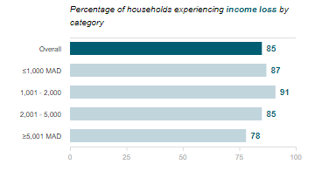
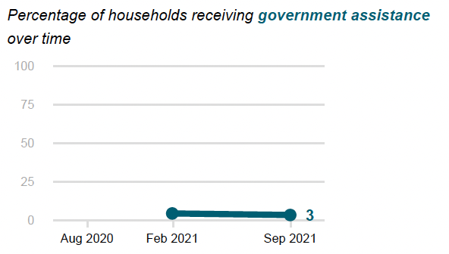
Are people experiencing income loss?
Almost nine out of 10 households (85%) reported losing some or all of their income since the start of the pandemic, on par with findings from February 2021 and higher than the Northern regional average (77%). Despite pervasive income loss, few respondents (3%) received financial or other support from the government.
Data Breakdown:
COVID-19 restrictions had serious economic repercussions for some major industries — including tourism — causing GDP to contract by 6.3% in 2020. Unemployment is at its highest in ten years, with job losses primarily affecting rural areas. Rural survey respondents reported greater rates of income loss than did urban respondents (88% vs. 83%).
Partnership for Evidence-based Response to COVID-19

Slide 23
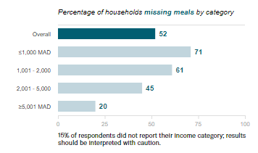
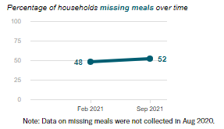
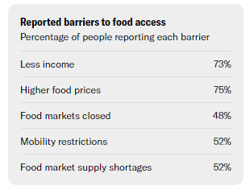
Are people experiencing food insecurity?
Almost nine out of 10 households (87%) in Morocco reported experiencing at least one barrier to accessing food. Half of respondents reported that they or someone in their household had to skip meals in the past week, higher than the Northern regional average (42%).
Data Breakdown:
Food insecurity has disproportionately affected lower-income households, with almost all of them reporting at least one barrier to food access compared to just three in five higher-income households (97% vs. 60%).
Partnership for Evidence-based Response to COVID-19

