Slide 1




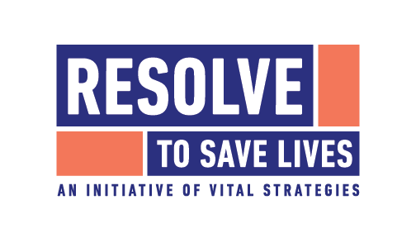





Finding the Balance:
Public Health and Social Measures in Sudan
Partnership for Evidence-based
Response to COVID-19 (PERC)
Data updated 26 February 2021

Slide 2

PERC Overview
The Partnership for Evidence-Based Response to COVID-19 (PERC) is a public-private partnership that supports evidence-based measures to reduce the impact of COVID-19 on African Union Member States.
PERC collects social, economic, epidemiological, population movement, and security data from 19 African Union Member States to help determine the acceptability, impact and effectiveness of public health and social measures for COVID-19.
This presentation focuses on findings from a telephone survey with 1,380 people conducted in February 2021. It is the third survey and analysis conducted since the pandemic began.

Slide 3
Table of Contents
Highlights
Disease Dynamics and PHSM Implementation
PSHM Support and Self-Reported Adherence
Risk Perceptions and Information
Secondary Burdens
Notes:
Situational awareness
Do people support and follow measures?
Whom do people trust?
How do people understand risk?
How do people feel about resuming activities?
What do people think about vaccines?
Are people skipping or delaying healthcare?
Are people experiencing income loss?
Are people experiencing food insecurity?

Slide 4

Highlights and Trend Analysis
Partnership for Evidence-based Response to COVID-19
Notes:
TALKING POINTS

Slide 5
Highlights: February 2021 survey
Sudan reported a second wave of increased COVID-19 transmission and deaths between November 2020 and February 2021, however, limited testing has hindered the ability to fully measure the impact of the outbreak.
Support for PHSMs targeting individual behavior was high in Sudan (90%). Support for measures that restrict social gatherings or movement, however, was much lower (62% and 72% respectively).
Respondents in Sudan reported the lowest levels of satisfaction in the government’s response to the pandemic among all African Union (AU) Member States surveyed. Perceptions of the risk that COVID-19 poses for the country were high; they were much lower at the individual level.
The myriad health, economic and security crises facing respondents in Sudan were evident. Of all those surveyed in the AU, respondents in Sudan were most likely to report difficulties accessing medicine (80%) and skipping or delaying health services (61%).

Slide 6
Highlights: August 2020 to February 2021 Trend
Support for PHSMs targeting individual behavior has increased by six percentage points since August. However, it has fallen by eight percentage points each for measures that restrict social gatherings or movement.
Satisfaction with the government’s COVID-19 response was 12 percentage points lower in February than in August, likely reflecting ongoing political turmoil amidst the recent appointment of a new transitional government and protests against soaring food prices.
Difficulty accessing medicine was higher in February than August among those who need medication (80% vs 71%)
Those reporting losing income since the start of the pandemic was considerably higher, from 38% in August to 74% in February.

Slide 7
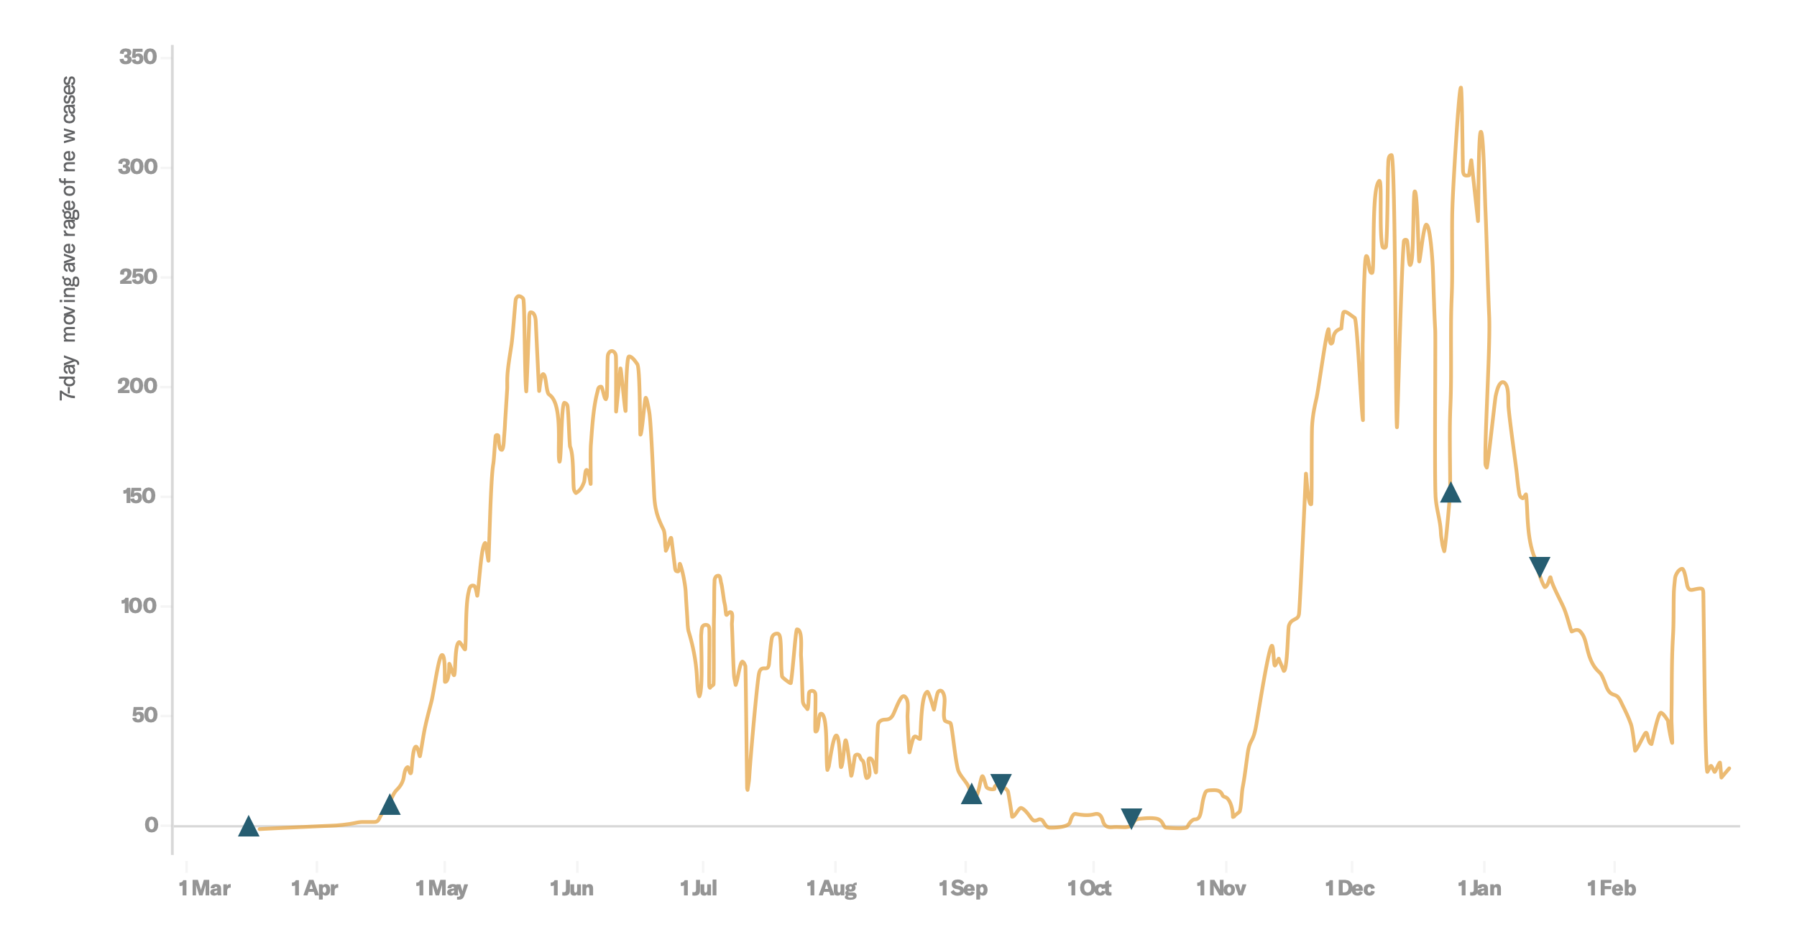
Survey Trend Highlights
 | Wave 2 | Wave 3 | Trend
Risk perception | 22% | 24% | ↑ 2%
Support for staying home | 83% | 76% | ↓ 7%
Government satisfaction | 66% | 54% | ↓ 12%
Income loss | 38% | 74% | ↑ 36%
Disease dynamics with indicators for tightening measures (▲) and loosening measures (▼)
Wave 2
Wave 3

Slide 8
Disease Dynamics and PHSM implementation
Partnership for Evidence-based Response to COVID-19
Notes:
TALKING POINTS

Slide 9
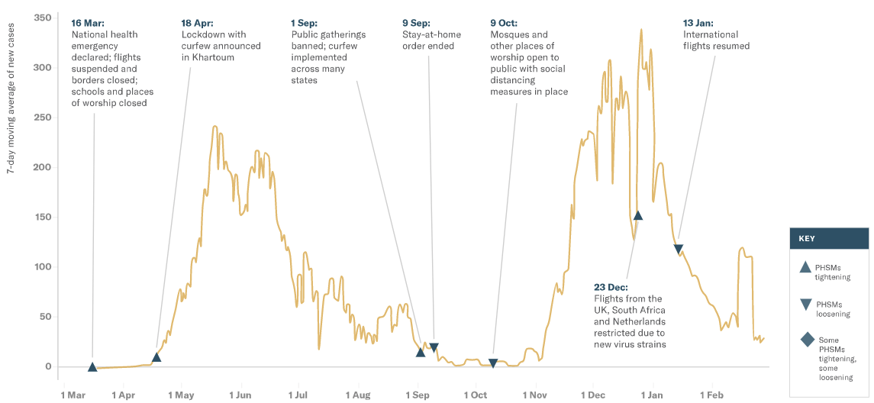
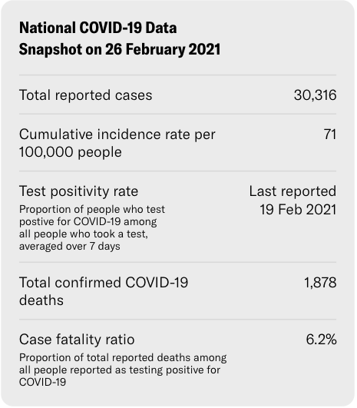
A second wave of new infections began in November 2020 and has since come down despite few major new PHSMs enacted in that time
Situational awareness
Partnership for Evidence-based Response to COVID-19
Notes:
Sudan experienced a second wave of new reported COVID-19 cases between early November 2020 and February 2021. New cases peaked in late December at 332 per day and have since returned to pre-wave levels. The precise timing and scale of the epidemic are hard to determine, however, given testing capacity constraints and sporadic reporting of testing data. Africa Centres for Disease Control and Prevention received testing data from Sudan only three times between 1 January and 14 March 2021.
While total confirmed COVID-19 deaths are low in Sudan (1,878), a recent report from the Imperial College of London estimated that only 2% of total COVID-19 deaths have been counted in Khartoum. Along with the high case-fatality rate (6.2%) reported, this suggests that the many cases and deaths are going uncounted and the overall impact is likely more serious than has been officially documented.
PHSMs in Sudan have been limited since October 2020, when mosques and places of worship were reopened. Other than a temporary ban on international flights from three countries with known outbreaks of SARS-CoV-2 variants of concern, there were no major new PHSMs put in place during the second wave of new infections. The lack of new restrictions may reflect the numerous other challenges the Sudanese government must prioritize, including economic, public health and political crises.
Sudan’s health system was already under significant pressure before the COVID-19 pandemic began and has faced a confluence of challenges over the past year, including medication shortages (due in part to COVID-19 supply-chain disruptions), malaria (which reached epidemic levels in 11 out of 18 states in October) and cholera outbreaks, among others. In September, Sudan sustained its worst floods in decades, affecting more than 800,000 people, increasing the risk of waterborne illnesses and further straining household livelihoods.
More than 61,000 refugees have arrived in eastern Sudan since the beginning of the conflict in the Tigray region of Ethiopia. Most are living in refugee camps or host communities in Kassala and Gedaref states, and there have been reports of COVID-19 outbreaks within these settlements.
Sudan is also facing a severe economic crisis. In October, inflation reached 230 percent, driving up prices for commodities and medicines, running down the country’s reserves of foreign exchange and forcing the government into a state of economic emergency.
Finally, Sudan’s political situation has remained fragile since the military ousted autocratic President Omar al-Bashir in April 2019. On 12 February, 2021—the same day fieldwork began for this survey—a transitional government was sworn in amidst political and economic protests. The new cabinet included three former leaders of armed groups intended to guide Sudan’s transition to democratic elections in 2022.

Slide 10
PHSM Support and Self-Reported Adherence
Partnership for Evidence-based Response to COVID-19
Notes:
TALKING POINTS

Slide 11
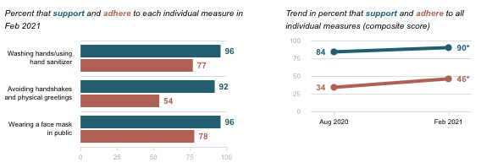
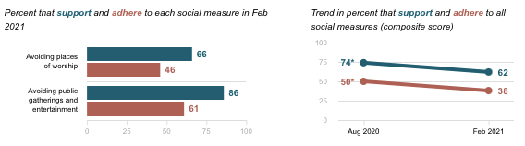
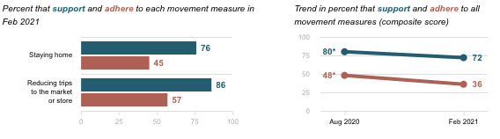
Individual measures
Do people support and follow measures?
Respondents from Sudan reported high levels of support for individual preventive measures. Support was higher than in the August 2020 survey, which may be the result of the recent second wave of new infections. By contrast, support for measures restricting social gatherings and movement was lower than in August, by eight and 12 percentage points, respectively.
Measures restricting social gatherings
Data Breakdown:
Self-reported adherence to all measures was considerably lower than support, likely representing the low levels of PHSMs in place during the survey period.
For all categories of measures, women were more likely to report adherence and tended to express higher rates of support.
Measures restricting movement
Partnership for Evidence-based Response to COVID-19
Partnership for Evidence-based Response to COVID-19
Notes:
The difference was greatest for measures restricting social gatherings; significantly more women than men reported support (66% vs 57%) and adherence (49% vs 28%).

Slide 12
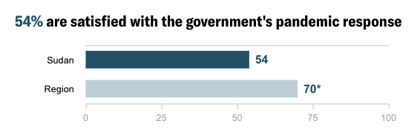
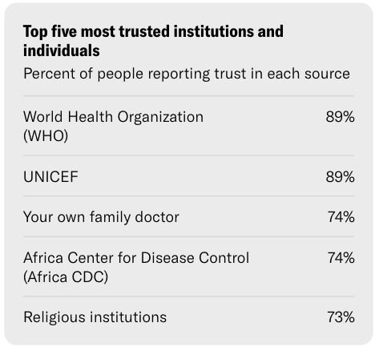
Whom do people trust?
Respondents in Sudan reported the lowest levels of satisfaction in the government’s pandemic response of all AU Member States surveyed, a drop of 12 percentage points since August. These findings reflect ongoing political turmoil amidst the recent appointment of a new transitional government (and power sharing agreement) and protests against soaring food prices.
Data Breakdown:
Respondents from lower-income households were more likely to report satisfaction in the government’s response (63%) than higher-income households (51%), and were similarly more likely to report trust in other government institutions, such as the Ministry of Health.
Partnership for Evidence-based Response to COVID-19
Notes:
Trust was higher for international institutions, such as the World Health Organization (WHO) (89%) and UNICEF (89%)—both of which have a large presence in Sudan—than for domestic institutions, including the Ministry of Health (69%).
Dissatisfaction with the government’s response was associated with lower rates of support for and self-reported adherence to all types of PHSMs.

Slide 13
Risk Perception and Information
Partnership for Evidence-based Response to COVID-19
Notes:
TALKING POINTS

Slide 14
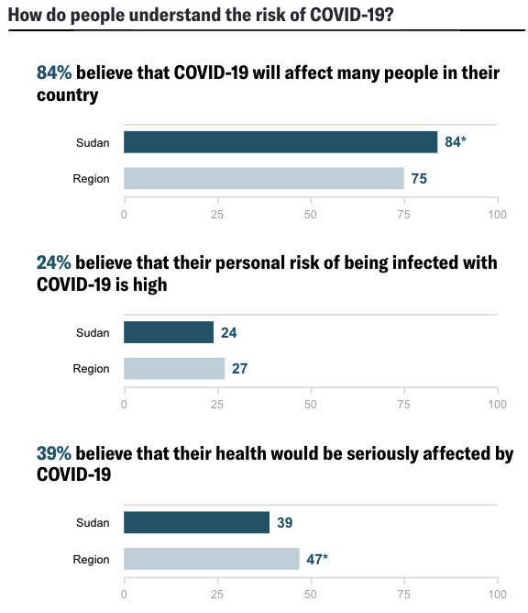
How do people understand risk?
Respondents from Sudan reported high levels of concern (84%) about the risk COVID-19 posed to their country; however, fewer than one in four (24%) believed they were at a high personal risk of contracting COVID-19.
Data Breakdown:
Compared to other countries in the Eastern region, a lower share of respondents from Sudan believed their health would be seriously affected if they were to become infected with COVID-19.
Partnership for Evidence-based Response to COVID-19
Notes:
Respondents’ risk perceptions are likely influenced by their own experience with COVID-19, which may explain the disconnect between the high level of concern for their country and low level of concern on the individual level. Nearly four in 10 (39%) reported knowing someone who has tested positive—the highest among Member States in the region—while only 9% of respondents believed they or a member of their household had been infected with COVID-19.

Slide 15
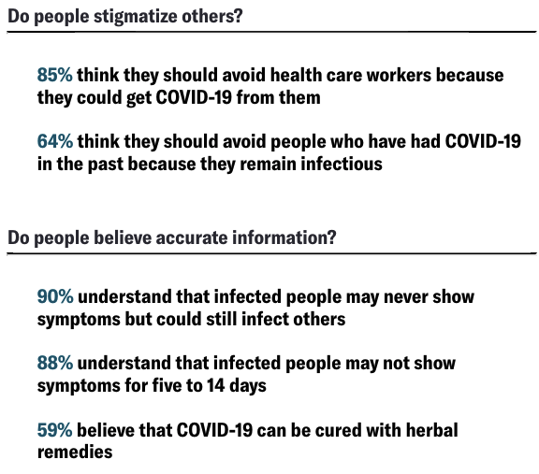
How do people understand risk?
More than eight in 10 respondents believed that health care workers should be avoided because they may transmit COVID-19—the most in any Member State surveyed.
Data Breakdown:
Understanding of asymptomatic transmission and carriage was high at about nine in 10 for both.
Belief in herbal remedies was also high at 59%.
Partnership for Evidence-based Response to COVID-19
Notes:
Almost nine in ten (87%) of those who reported skipping or delaying a health service visit since the start of the pandemic expressed stigma toward health care workers. Stigma around recovered COVID-19 patients was also high at nearly two in three (64%).
Violent episodes in North Darfur further highlight stigma concerns. Doctors have been targeted, ostensibly due to priority access to petrol and other services they receive. One such attack led to a strike among doctors to raise awareness of the situation.

Slide 16
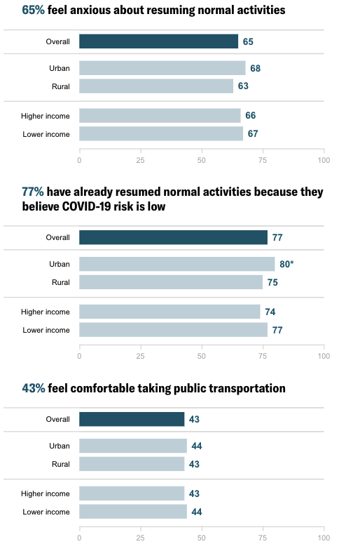
How do people feel about resuming activities?
More than three in four respondents (77%) reported that they have resumed normal activities, among the highest rates of all Member States surveyed. However, anxiety around these activities (65%) and comfort in taking public transportation (43%) were roughly average for the AU. Taken together, these data suggest that COVID-19 concerns are being outweighed by necessity.
Data Breakdown:
Respondents in urban settings were more likely to report resuming activities; no other significant demographic differences identified.
Partnership for Evidence-based Response to COVID-19
Notes:
Those satisfied with the government’s pandemic response were 14% more likely to express anxiety about returning to normal activities, but were also more likely to report resuming those activities.

Slide 17
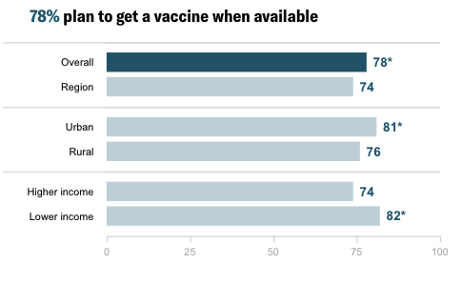
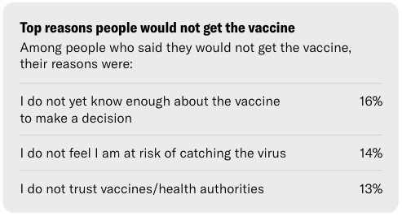
What do people think about vaccines?
A large majority of respondents from Sudan (78%) reported planning to get a vaccine when one becomes available. On 3 March, Sudan received its first delivery of 828,000 doses of AstraZeneca vaccine from the COVAX facility.
Data Breakdown:
Urban and lower-income respondents reported greater interest in vaccination compared to rural and higher-income respondents.
Younger respondents were also more likely to express interest, but the sample size of respondents over 56 was too small to draw a comparison.
Partnership for Evidence-based Response to COVID-19
Notes:
No single reason for vaccine hesitancy predominated (or received more than 20% of the total share of responses). The top reason cited was lack of information (16%), suggesting that a concerted community engagement effort could improve future vaccine uptake.

Slide 18
Secondary Burdens
Partnership for Evidence-based Response to COVID-19
Notes:
TALKING POINTS

Slide 19
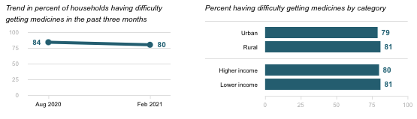
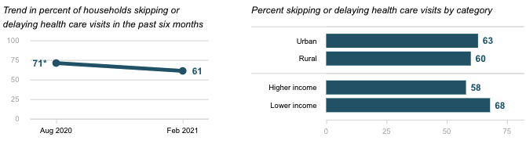
Are people skipping or delaying healthcare?
Difficulty getting medicines
80% of respondents who said that they or someone in their household needed medication reported difficulty obtaining it; more than 60% reported skipping or delaying needed health services.
Data Breakdown:
While slightly lower than in August, these were the highest levels reported among all Member States surveyed, highlighting significant gaps in Sudan’s health care system.
Skipping or delaying health visits
Partnership for Evidence-based Response to COVID-19
Notes:
An estimated 9.2 million people are in need of health care in Sudan, and access to health facilities has been limited by recent crises. In Khartoum state, nearly half of the health centers have closed since the start of the pandemic; in Darfur, a quarter of facilities were closed in 2018 due to lack of funds and staff.

Slide 20
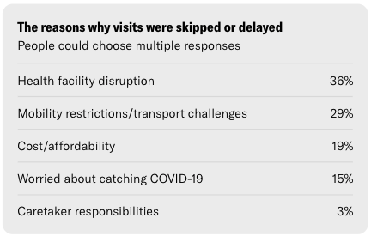
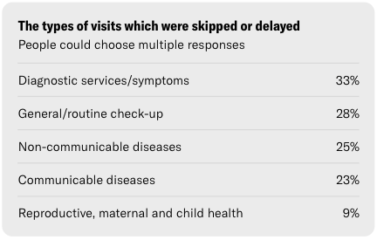
Are people skipping or delaying healthcare?
As in August, the most common reason reported for missing services was health facility disruption (e.g., staff shortages or hospitals being closed/too busy).
Data Breakdown:
Of the respondents that had missed or delayed care, more than 20% reported skipping a visit for malaria treatment. In October 2020, malaria reached epidemic levels in 11 of Sudan’s 18 states.
Partnership for Evidence-based Response to COVID-19

Slide 21
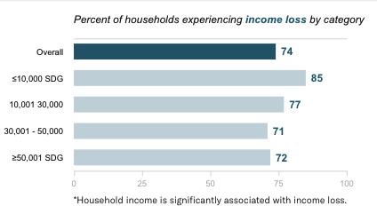
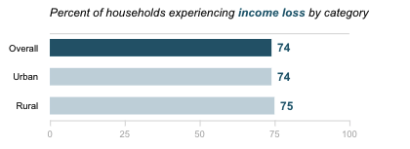
Are people experiencing income loss?
The economic and food security challenges facing respondents in Sudan were pervasive. Nearly three in four (74%) reported lost income since the start of the pandemic.
Data Breakdown:
In October 2020, the Sudanese government and the World Bank launched a US $400 million Family Support Programme “Samarat” to provide cash transfers and improve social protection systems and safety nets. However, only 5% of survey respondents reported receiving any support from the government, with just 1% receiving food supplements or cash transfers.
Partnership for Evidence-based Response to COVID-19

Slide 22
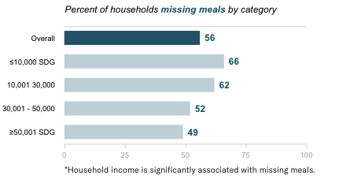
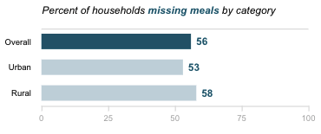
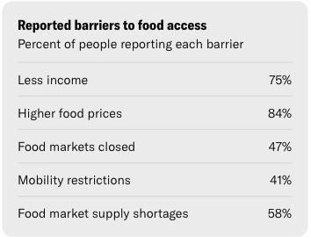
Are people experiencing food insecurity?
Over half (56%) reported having to skip or reduce the portion size of a meal in the previous week. 84% of respondents reported higher food prices were a barrier to access and nearly one in five (19%) of those who skipped or delayed a health service cited cost as a reason.
Data Breakdown:
Two in three respondents from the lowest income bracket reported having to skip or reduce the portion size of a meal, compared to about half (49%) from the highest income group (itself a notably high share).
Partnership for Evidence-based Response to COVID-19
Notes:
Sudan’s soaring inflation appears to be a likely root cause of economic hardship;
Severe floods in the final quarter of 2020 and the ongoing economic crisis have hurt agricultural productivity and exacerbated food insecurity. An estimated 7.1 million people were severely food insecure in December 2020—a 22% increase from the same period in 2019—while 1.3 million people were facing emergency levels of acute food insecurity.

