Slide 1










Finding the Balance:
Public Health and Social Measures in Mozambique
Partnership for Evidence-based
Response to COVID-19 (PERC)
Data updated 26 February 2021

Slide 2

PERC Overview
The Partnership for Evidence-Based Response to COVID-19 (PERC) is a public-private partnership that supports evidence-based measures to reduce the impact of COVID-19 on African Union Member States.
PERC collects social, economic, epidemiological, population movement, and security data from 19 African Union Member States to help determine the acceptability, impact and effectiveness of public health and social measures for COVID-19.
This presentation focuses on findings from a telephone survey with 1,333 people conducted in February 2021. It is the third survey and analysis conducted since the pandemic began.

Slide 3
Table of Contents
Highlights
Disease Dynamics and PHSM Implementation
PSHM Support and Self-Reported Adherence
Risk Perceptions and Information
Secondary Burdens
Notes:
Situational awareness
Do people support and follow measures?
Whom do people trust?
How do people understand risk?
How do people feel about resuming activities?
What do people think about vaccines?
Are people skipping or delaying healthcare?
Are people experiencing income loss?
Are people experiencing food insecurity?

Slide 4

Highlights and Trend Analysis
Partnership for Evidence-based Response to COVID-19
Notes:
TALKING POINTS

Slide 5
Highlights: February 2021 survey
Mozambique experienced a surge in reported COVID-19 cases in January and February, when reported cases reached 900 per day (more than four times the incidence detected during the previous wave). With test positivity around 30% during the peak, many cases and deaths have likely gone undetected.
PHSM support and self-reported adherence were high, although a much lower share of people reported staying home or reducing trips to markets, reflecting the challenges people faced in adhering to economically restrictive measures.
Perceptions of COVID-19 risk were high in Mozambique compared to other African Union Member States in the Southern Region. While almost 90% of respondents believed COVID-19 would affect many people in their country, fewer (47%) believed COVID-19 posed a risk to them personally.
The COVID-19 pandemic is exacerbating economic hardships in Mozambique. Two-thirds of households reported that their income had fallen and more than half were forced to restrict food consumption.

Slide 6
Highlights: August 2020 to February 2021 Trend
PHSM support and adherence has remained relatively stable since the August 2020 survey, despite increased transmission in January and February 2021.
There was a marked increase in reported satisfaction for the government's COVID-19 response since August (from 72% satisfaction to 85%).
Perceptions of risk to the country and personal risk of catching COVID-19 were both higher than in August, in line with the worsening epidemiological situation in Mozambique.

Slide 7
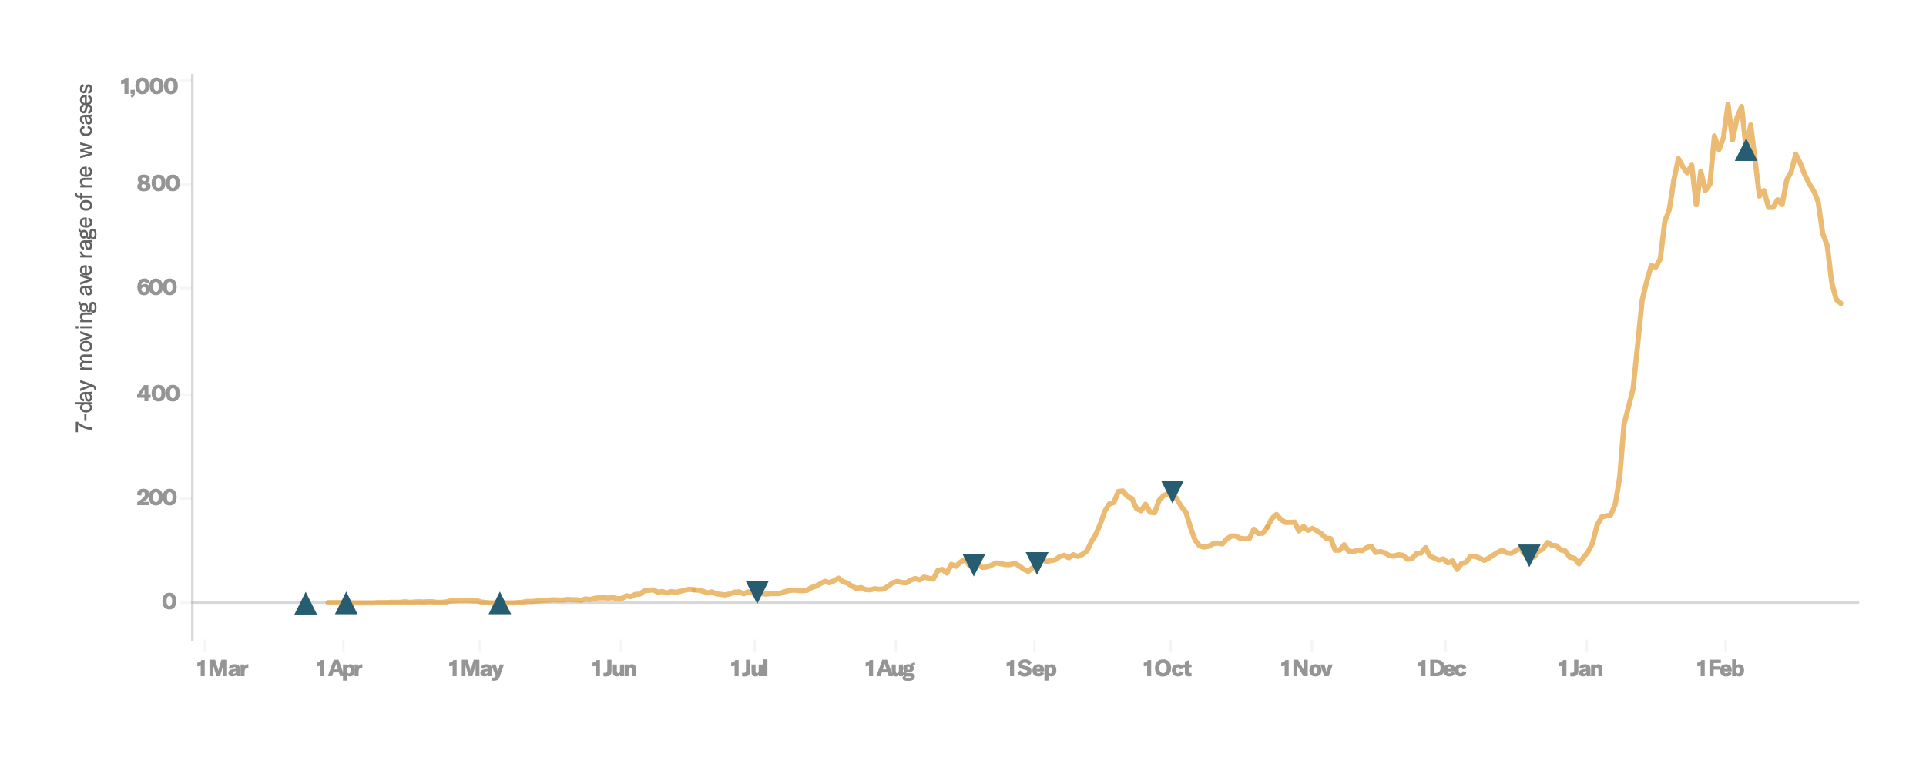
Survey Trend Highlights
 | Survey 2 | Survey 3 | Trend
Personal risk perception | 37% | 47%* | ↑ 10%
Support for staying home | 88%* | 83% | ↓ 5%
Government satisfaction | 72% | 85%* | ↑ 13%
Income loss | 68% | 61% | ↓ 7%
Disease dynamics with indicators for tightening measures (▲) and loosening measures (▼)
Survey 2
Survey 3

Slide 8
Disease Dynamics and PHSM Implementation
Partnership for Evidence-based Response to COVID-19
Notes:
TALKING POINTS

Slide 9
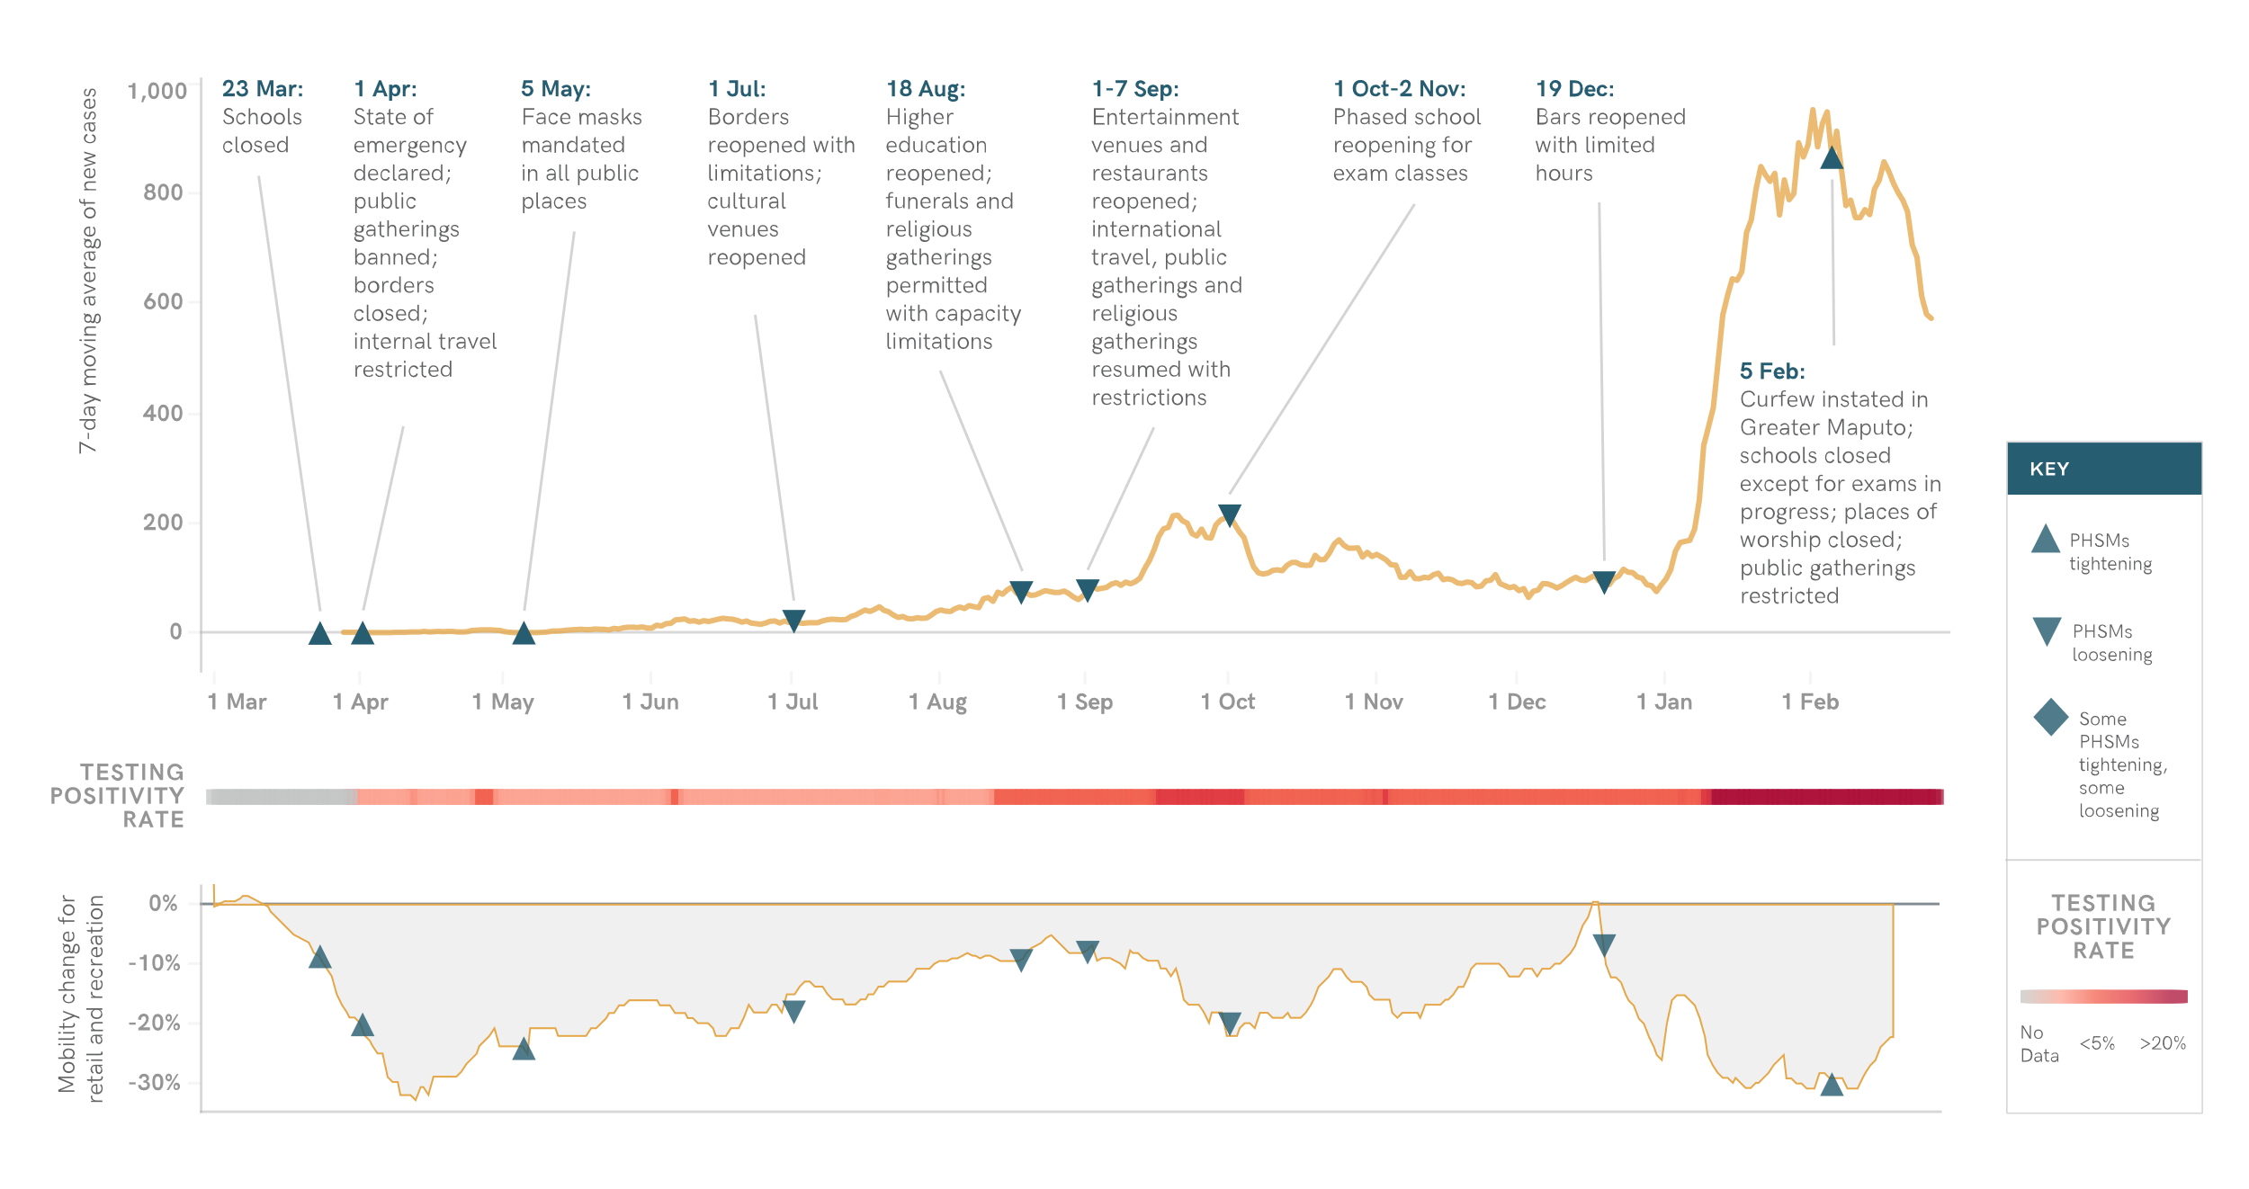
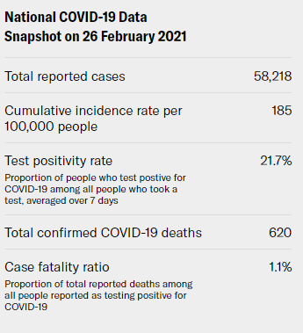
Situational Awareness
After rising in December, mobility declined as reported COVID-19 cases surged in January.
Notes:
Mozambique experienced a sharp increase in reported cases and deaths at the beginning of January 2021, reaching a peak of around 900 new reported cases per day by early February, more than four times the reported incidence during the previous peak in September 2020. While Greater Maputo continues to report the most cases, other provinces are also experiencing outbreaks. In response to the surge in cases, the Mozambican government imposed a month-long curfew in Greater Maputo on 5 Feb, closed schools and places of worship, and restricted public gatherings.
The 501Y.V2 (B.1.351) variant has been detected in multiple samples, and has likely been circulating in Mozambique since November. Cross-border travel and trade between South Africa and Mozambique has likely contributed to the worsening epidemiological situation, along with increased mobility during the end-of-year holidays. Mobility declined again in January, possibly as a reaction to the sudden increase in reported cases, news of the B.1.351 variant, and a post-holiday lull in economic activity. Long delays at the South African border in early January as people returned to work after the holidays may have also exacerbated transmission before the South African government closed its land borders on 11 Jan.
Testing capacity is low, with test positivity reaching 30% in late January and early February, suggesting that many cases and deaths in the current surge have gone undetected. Mozambique received 200,000 initial doses of the Sinopharm vaccine on 24 Feb, which will be administered to health care workers. The government expects further vaccine doses through the COVAX partnership in May.
The COVID-19 surge has come on top of an escalating conflict and humanitarian crisis in Cabo Delgado province, where nearly 700,000 people had been displaced by the end of 2020. In Central Mozambique, tropical cyclone Eloise also led to displacement in January 2021.

Slide 10
PHSM Support and Self-Reported Adherence
Partnership for Evidence-based Response to COVID-19
Notes:
TALKING POINTS

Slide 11
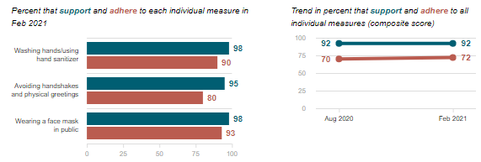
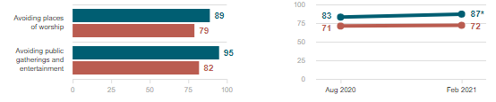
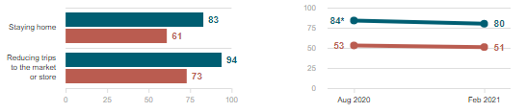
Do people support and follow measures?
Individual measures
Support for all PHSMs has remained relatively stable since August 2020, even though transmission was much higher in February 2021 when the most recent survey was conducted.
Social measures
Data Breakdown:
Both support for and adherence to all measures were similar across socio-demographic groups.
In contrast to survey findings, many social media users were critical of the increased restrictions announced in early February, raising concerns about police enforcement and economic impact.
Economic measures
Partnership for Evidence-based Response to COVID-19
Partnership for Evidence-based Response to COVID-19

Slide 12
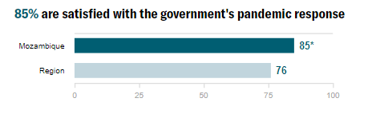
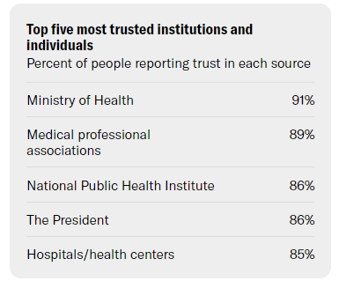
Whom do people trust?
Respondents in Mozambique reported greater satisfaction with their government’s response to COVID-19 (85%) than the regional average (76%). This is a marked increase from the August survey, when only 72% of respondents reported satisfaction.
Data Breakdown:
Trust was highest for governmental and medical institutions responsible for managing the COVID-19 response.
Both the media and religious institutions also play and important role in promoting PHSM adherence, with 76% of survey respondents saying they trusted the media, and 71% expressing trust in religious institutions.
Partnership for Evidence-based Response to COVID-19

Slide 13
Risk Perceptions and Information
Partnership for Evidence-based Response to COVID-19
Notes:
TALKING POINTS

Slide 14
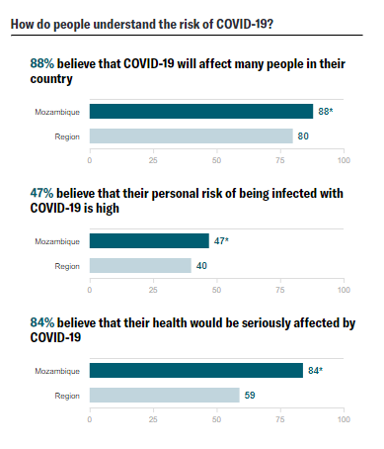
How do people understand risk?
While nearly nine in ten survey respondents said that COVID-19 will affect many Mozambicans, less than half said they were personally at high risk. Risk perceptions in Mozambique were high compared to the regional average.
Data Breakdown:
Perceptions of COVID-19 risk—both risk to the country and personal risk of catching the virus—were higher in February 2021 compared to August 2020, in line with the epidemiological situation both in Mozambique and neighboring South Africa.
Risk perceptions were broadly similar across socio-demographic groups.
Partnership for Evidence-based Response to COVID-19

Slide 15
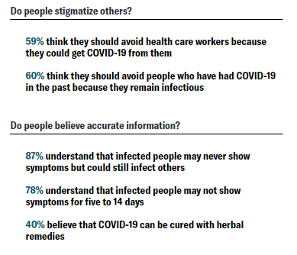
How do people understand risk?
Respondents reported high knowledge of COVID-19 transmission and asymptomatic carriage. However, approximately six in ten respondents indicated health care workers and people who had recovered from COVID-19 should be avoided, beliefs which could potentially lead to stigma or cause people to avoid health care.
Data Breakdown:
COVID-19 was not a major topic of discussion among social media users, suggesting that the pandemic may be a secondary concern for many people.
Among social media users, there were some misinformation narratives suggesting that COVID-19 cases were being exaggerated by the government, which may undermine risk perceptions and preventive behaviors.
Partnership for Evidence-based Response to COVID-19

Slide 16
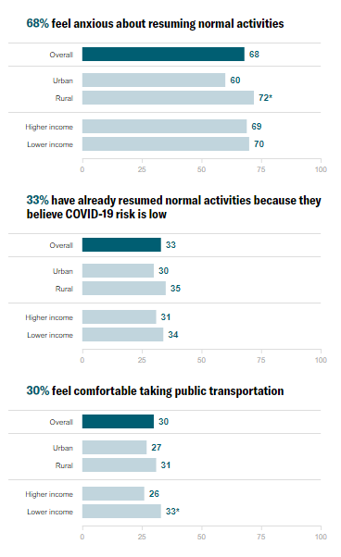
How do people feel about resuming activities?
About two-thirds of survey respondents indicated that the thought of resuming normal activities makes them anxious, a similar share as in the August survey, while one in three reported they had already resumed normal activities by February.
Data Breakdown:
People in lower-income households were more likely to have resumed normal activities or be comfortable taking public transportation, reflecting that lower-income individuals may have fewer options available to protect themselves from risk of infection.
Rural survey respondents were more anxious about resuming activities.
Partnership for Evidence-based Response to COVID-19

Slide 17
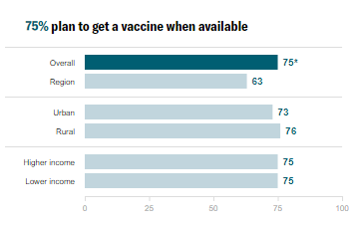
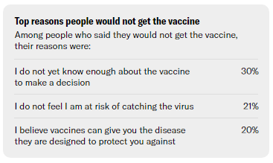
What do people think about vaccines?
Three in four survey respondents indicated that they would plan to get a vaccine when it was available—with 47% definitely planning to get vaccinated and 28% probably planning to get vaccinated. Reported vaccine acceptance was substantially higher than other surveyed Member States in the Southern Region.
Data Breakdown:
Rates of vaccine acceptance were similar across socio-demographic groups and levels of risk perception.
Of those who indicated they were not ready to get vaccinated, almost a third (30%) cited a lack of information as their rationale.
Partnership for Evidence-based Response to COVID-19
Partnership for Evidence-based Response to COVID-19

Slide 18
Secondary Burdens
Partnership for Evidence-based Response to COVID-19
Notes:
TALKING POINTS

Slide 19
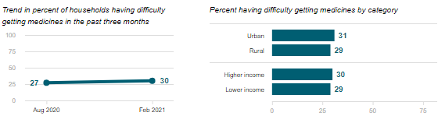
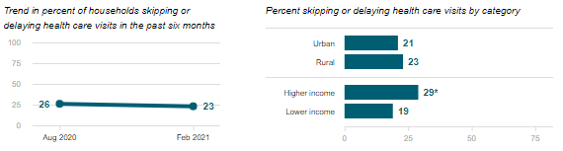
Are people skipping or delaying healthcare?
Difficulty getting medicines
Since August, the share of respondents reporting difficulty accessing needed medication or skipping a needed health visit has remained stable.
Data Breakdown:
The share of respondents reporting difficulty accessing needed medicine was higher (34%) among households that have lost income during the pandemic compared to 23% of households have not lost income.
Households that have lost income and people with longstanding illnesses were more likely to report skipping care.
Skipping or delaying health visits
Partnership for Evidence-based Response to COVID-19

Slide 20
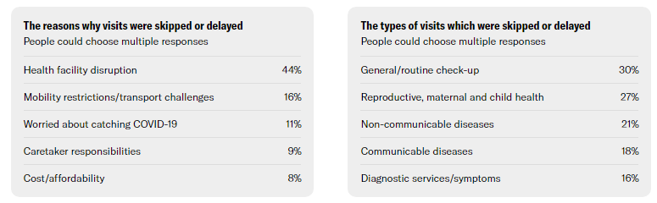
Are people skipping or delaying healthcare?
Among households that missed visits, the most common reason was health facility disruption. The Cabo Delgado conflict has resulted in the closure of many health facilities and displacement of health care workers, leaving some areas with no functional clinics.
Data Breakdown:
Around one in four missed visits in the previous six months were for reproductive, maternal, newborn and child health. A substantial share were also for malaria (13%) or fever/chills (10%), symptoms which may overlap with COVID-19, which suggests cases may be going undetected.
Partnership for Evidence-based Response to COVID-19

Slide 21
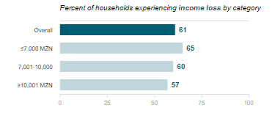
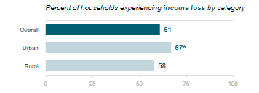
Are people experiencing income loss?
More than 60% of respondents reported losing some or all of their income since the start of the pandemic. Of those households experiencing decreased income, more than one in three (39%) reported a “large” drop in income or lost all their income.
Data Breakdown:
Lower-income and urban households were more likely to report income losses.
The government launched a cash transfer program in September to alleviate the economic impact of the pandemic, with donor support. However, in the February survey, only 1% of households reported having received any additional government assistance in the previous month, a similar share to the August survey (2%).
Partnership for Evidence-based Response to COVID-19

Slide 22
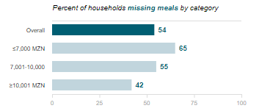
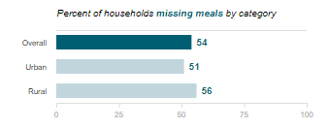
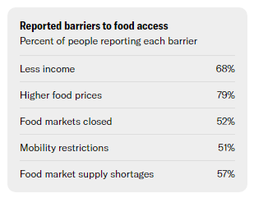
Are people experiencing food insecurity?
More than half of households were forced to limit meals or portion sizes in the previous week, with the most significant barriers to food access being rising food prices and falling incomes.
Data Breakdown:
Food insecurity affected lower-income and less-educated households more.
The economic impact of the pandemic is exacerbating other ongoing crises, including the ongoing conflict in the Cabo Delgado province and Cyclone Eloise, which caused flooding in central Mozambique in January. Nearly one million people are facing crisis levels of acute food insecurity (IPC Phase 3 or higher), with the majority of those affected in Cabo Delgado and neighboring provinces. The conflict has reportedly reduced agricultural yields and disrupted supply chains, causing rising food prices.
Partnership for Evidence-based Response to COVID-19

