Slide 1










Finding the Balance:
Public Health and Social Measures in Liberia
Partnership for Evidence-based
Response to COVID-19 (PERC)
Data updated 26 February 2021

Slide 2

PERC Overview
The Partnership for Evidence-Based Response to COVID-19 (PERC) is a public-private partnership that supports evidence-based measures to reduce the impact of COVID-19 on African Union Member States.
PERC collects social, economic, epidemiological, population movement, and security data from 19 African Union Member States to help determine the acceptability, impact and effectiveness of public health and social measures for COVID-19.
This presentation focuses on findings from a telephone survey with 1,313 people conducted in February 2021. It is the third survey and analysis conducted since the pandemic began.

Slide 3
Table of Contents
Highlights
Disease Dynamics and PHSM Implementation
PSHM Support and Self-Reported Adherence
Risk Perceptions and Information
Secondary Burdens
Notes:
Situational awareness
Do people support and follow measures?
Whom do people trust?
How do people understand risk?
How do people feel about resuming activities?
What do people think about vaccines?
Are people skipping or delaying healthcare?
Are people experiencing income loss?
Are people experiencing food insecurity?

Slide 4

Highlights and Trend Analysis
Partnership for Evidence-based Response to COVID-19
Notes:
TALKING POINTS

Slide 5
Highlights: February 2021 survey
Liberia has reported fewer cases of COVID-19 than other African Union Member States in the Western Region, with just over 2,000 in total as of February 2021. Incidence has remained low since the first wave of transmission in June 2020, although there was an uptick in December 2020 after nationwide senatorial elections.
While approximately three-quarters of respondents expressed trust in government institutions—including the president and the Ministry of Health—this is less than almost all other surveyed Member States in the Western region.
Despite fewer reported COVID-19 cases in Liberia, respondents reported higher levels of personal risk perception compared to the regional average.
Survey data showed meaningful economic disparities in accessing essential medical care in Liberia: respondents that lost some or all of their income since the start of the pandemic reported greater trouble accessing medication than those that lost no income.

Slide 6
Highlights: August 2020 to February 2021 Trend
Support for and self-reported adherence to all PHSMs have declined since August. Adherence to individual measures in particular has declined, with an 11 percentage point decrease in adherence overall. Low adherence may reflect the fact that few measures are mandatory in Liberia.
Reported satisfaction with the government’s response was similar to August, but trust in nearly all institutions decreased.
Almost three in five respondents (57%) believed that COVID-19 would affect their country, but far fewer (34%) believed they would personally be affected by the virus. Since August, perceived levels of risk have remained similar.
The share of households that reported trouble accessing medication or skipping a needed health visit has remained the same since August 2020.

Slide 7
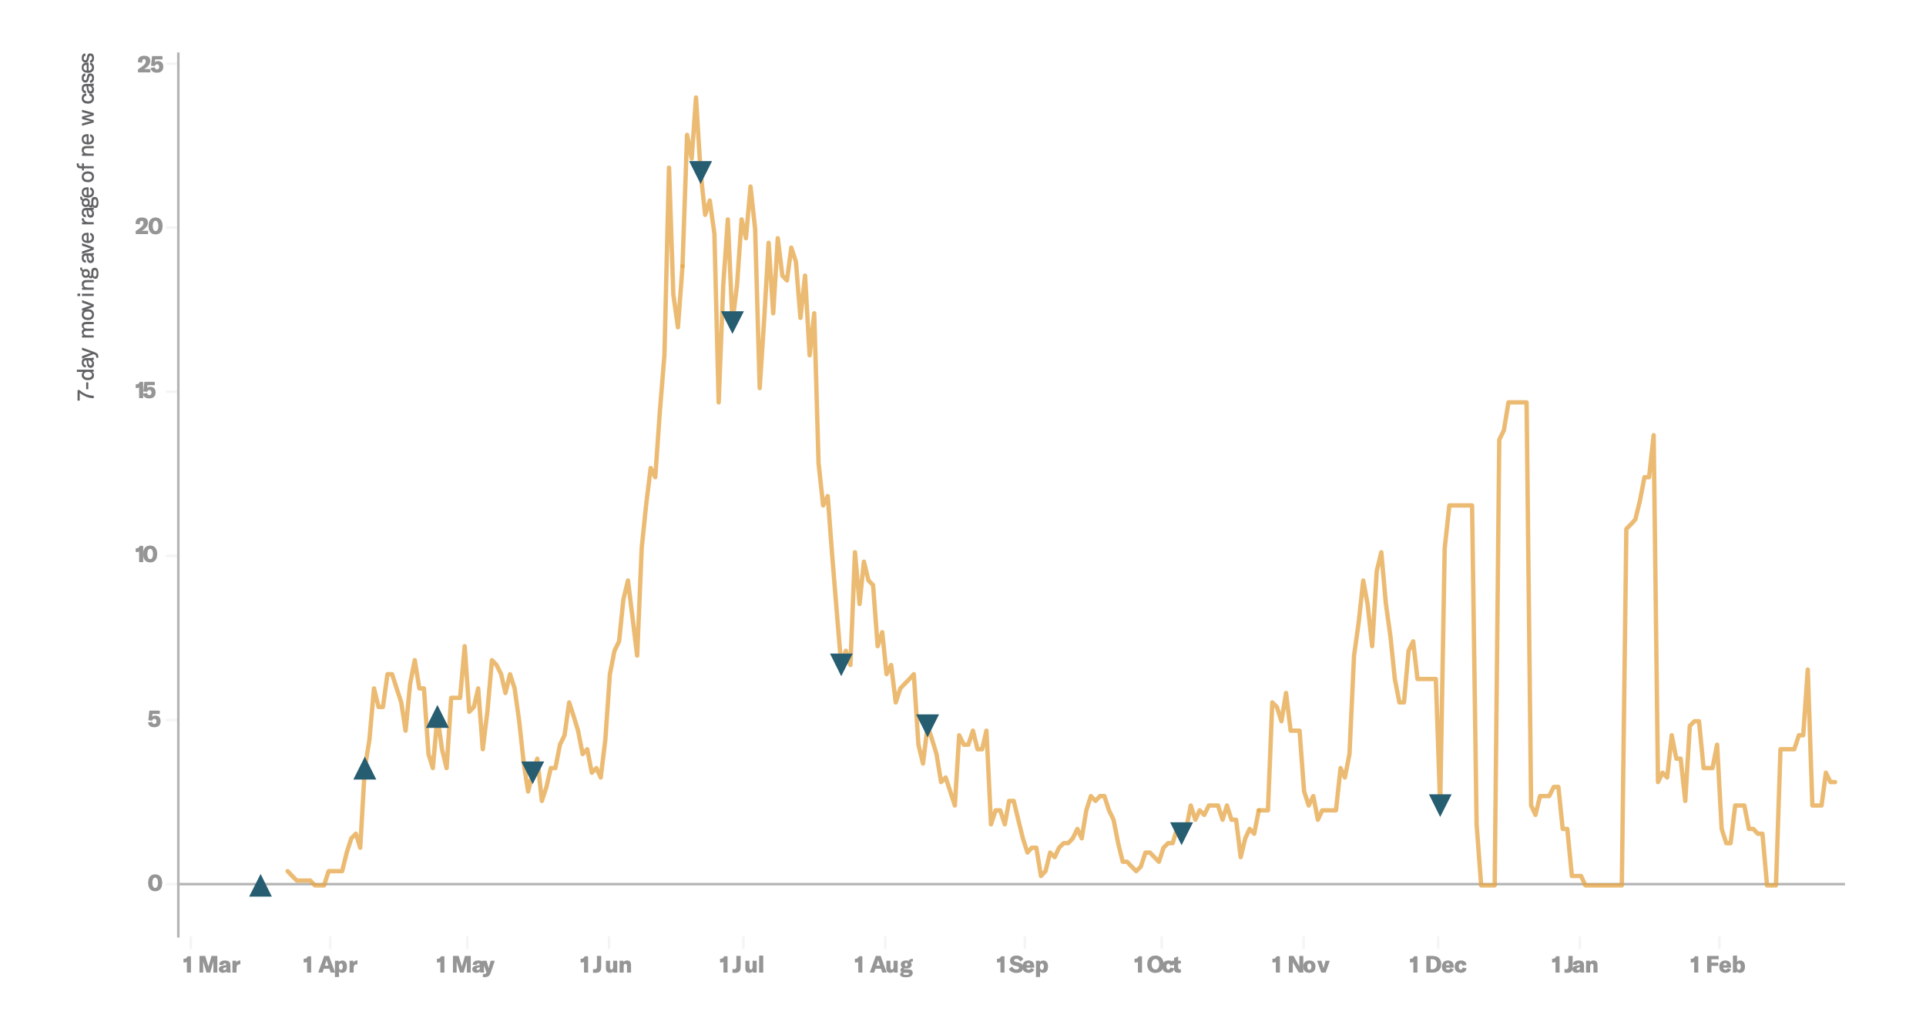
Survey Trend Highlights
 | Survey 2 | Survey 3 | Trend
Personal risk perception | 33% | 34% | ↑ 1%
Support for staying home | 69%* | 60% | ↓ 9%
Government satisfaction | 69% | 73% | ↑ 4%
Income loss | 81% | 78% | ↑ 3%
Disease dynamics with indicators for tightening measures (▲) and loosening measures (▼)
Survey 2
Survey 3

Slide 8
Disease Dynamics and PHSM implementation
Partnership for Evidence-based Response to COVID-19
Notes:
TALKING POINTS

Slide 9
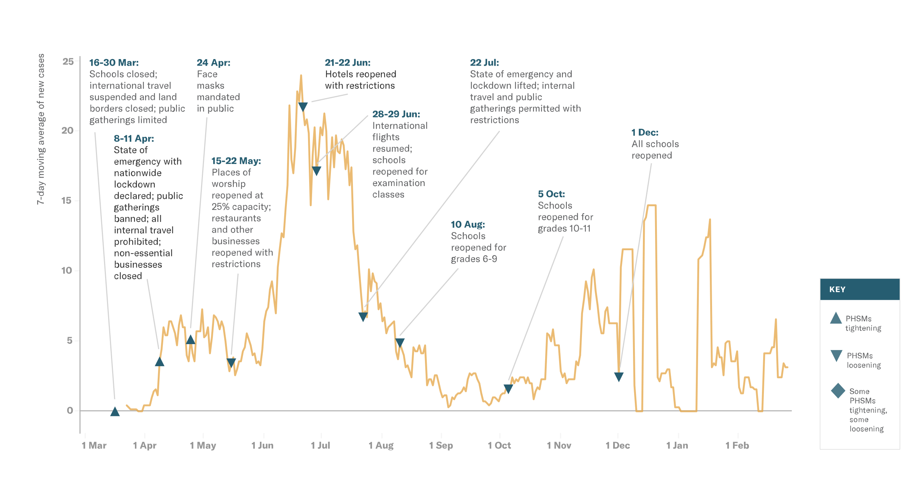
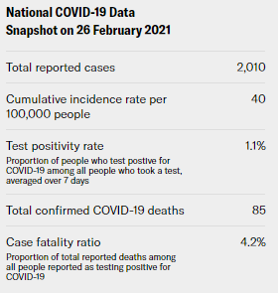
Situational Awareness
New cases began to rise slightly in December 2020 after most restrictions put in place during the first wave were loosened. Infrequent reporting of data helps explain the variation in the epidemic curve below.
Notes:
Despite a recent uptick, COVID-19 transmission has remained very low in Liberia since the first wave in June 2020. On 16 December 2020, Liberia reported 95 new cases—its highest single-day total since the start of the pandemic—shortly after nationwide senatorial elections were held with reportedly little observation of COVID-19 safety protocols. Cases have since declined, with the 7-day moving average hovering between two and four new cases per day in February. Incidence and test positivity remain low compared to other countries in the Western region. However, the case-fatality ratio in Liberia is the highest in the Western region, which could indicate cases are going undetected, or there may be a lack of access to adequate care. Given the elevated case-fatality ratio the surveillance and testing strategy may need to be adjusted to ensure that all cases are being identified.
There have been no new PHSMs implemented in Liberia since April 2020. Multiple reports have noted a public disregard for individual protective measures such as mask-wearing and social distancing, which some officials warn may have contributed to the recent increase in cases.
Liberia received 96,000 doses of the AstraZeneca vaccine from the World Health Organization’s (WHO) COVAX facility in March and will begin priority administration to health care workers.
Liberia is experiencing an influx of migrants from neighbouring Côte d’Ivoire, where political instability has forced more than 23,000 refugees to flee to Liberia as of January 2021. Cases of Ebola were also identified near the Liberian border in Guinea Conakry; the president ordered health authorities to increase surveillance and preventive measures to avoid an outbreak. All suspected cases have so far tested negative.

Slide 10
PHSM Support and Self-Reported Adherence
Partnership for Evidence-based Response to COVID-19
Notes:
TALKING POINTS

Slide 11
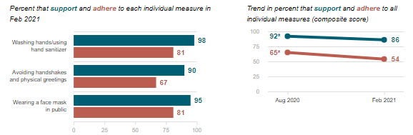
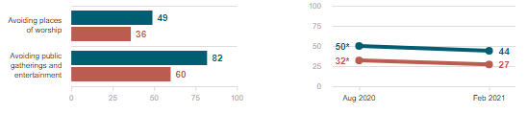
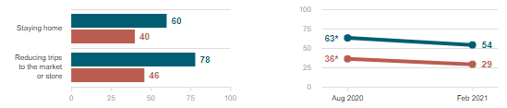
Do people support and follow measures?
Individual measures
Support for and self-reported adherence to all PHSMs in Liberia has declined since August 2020. The lack of mandates may have contributed to low PHSM adherence.
Measures restricting social gatherings
Data Breakdown:
Lower-income respondents reported less adherence than higher-income respondents to nearly all PHSMs, particularly social measures (20% vs. 33%), suggesting an economic barrier to compliance.
Measures restricting movement
Partnership for Evidence-based Response to COVID-19
Partnership for Evidence-based Response to COVID-19

Slide 12
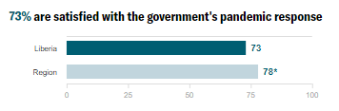
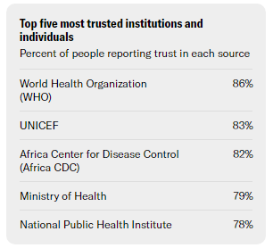
Whom do people trust?
Reported satisfaction with the government’s response was similar to August, but trust in nearly all institutions decreased. Respondents in Liberia reported lower overall satisfaction in their government’s response to COVID-19 than the regional average, and has the second-lowest approval rating in the Western Region after Nigeria (65%)
Data Breakdown:
Male respondents reported a significant increase in satisfaction for the government’s response (from 67% in August to 75%). This is consistent with additional survey results that show male respondents reported a fivefold increase in receiving food assistance from the government since August.
Partnership for Evidence-based Response to COVID-19

Slide 13
Risk Perception and Information
Partnership for Evidence-based Response to COVID-19
Notes:
TALKING POINTS

Slide 14
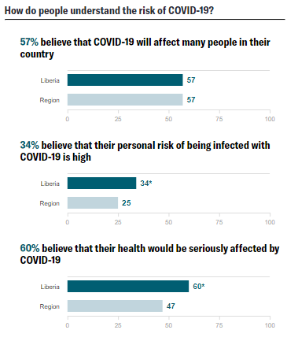
How do people understand risk?
Almost three in five respondents (57%) believed that COVID-19 would affect their country, but far fewer (34%) believed they would personally be affected by the virus. Since August, perceived levels of risk have remained similar.
Data Breakdown:
Low personal risk perception may be related to the fact that few respondents knew someone who had tested positive to COVID-19 (12%), and therefore had little personal experience with the virus.
Partnership for Evidence-based Response to COVID-19

Slide 15
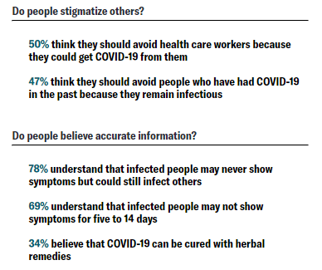
How do people understand risk?
Reported understanding of COVID-19 transmission and asymptomatic carriage among respondents in Liberia was some of the lowest in the Western region. Respondents in Liberia also reported the lowest levels of belief in the efficacy of herbal remedies to cure COVID-19.
Data Breakdown:
Rural and higher-income respondents were more likely than urban and lower-income respondents to report a belief in the efficacy of herbal remedies (40% for rural vs. 30% for urban; 41% high income vs. 31% for low income).
Partnership for Evidence-based Response to COVID-19

Slide 16
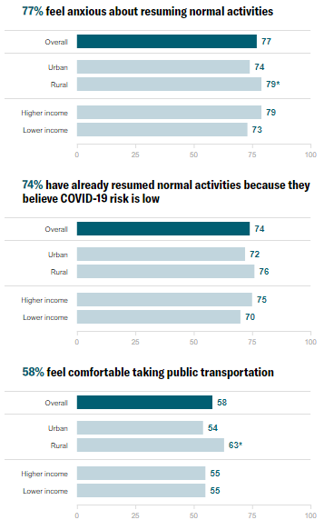
How do people feel about resuming activities?
More than three-fourths of respondents felt anxious about resuming normal activities (77%). Despite this, an almost equal number of respondents (74%) reported having already resumed daily activities.
Data Breakdown:
More respondents reporting no income loss since the pandemic began have resumed normal activities (79%) than those who lost all (66%) or some (74%) of their income, suggesting motivations beyond economic necessity.
Partnership for Evidence-based Response to COVID-19

Slide 17
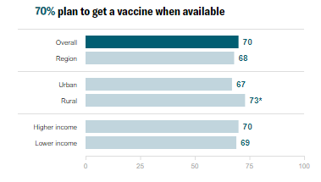
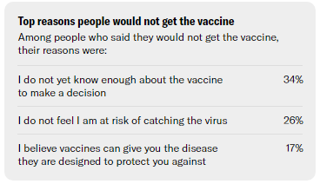
What do people think about vaccines?
The majority of respondents in Liberia would definitely or probably get a COVID-19 vaccine (70%), on par with regional findings (68%).
Data Breakdown:
Among respondents who did not plan to get vaccinated, about one in three (34%) stated they needed more information.
In line with the low reported personal risk perception, about one in four respondents said they did not need the vaccine because they were not at risk of catching COVID-19.
Partnership for Evidence-based Response to COVID-19

Slide 18
Secondary Burdens
Partnership for Evidence-based Response to COVID-19
Notes:
TALKING POINTS

Slide 19
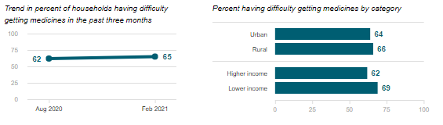
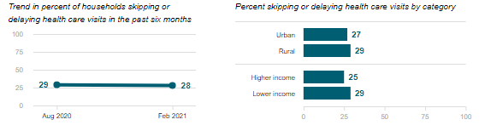
Are people skipping or delaying healthcare?
Difficulty getting medicines
Among respondents who reported that they or someone in their household needed health care or medication, 28% skipped or delayed services in the previous six months and 65% reported difficulty obtaining medication in the previous three months—on par with findings from August 2020.
Data Breakdown:
Respondents with high risk perception were more likely to skip or delay a health visit (32%) than those with low risk perception (25%). Respondents with high risk perception were also more likely to believe that health care workers should be avoided to prevent transmission, which may contribute to their greater tendency to skip or delay care.
Skipping or delaying health visits
Partnership for Evidence-based Response to COVID-19

Slide 20
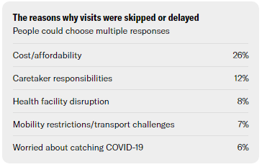
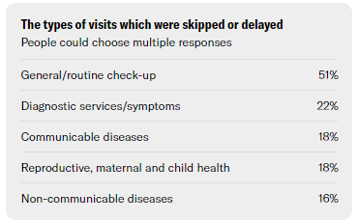
Are people skipping or delaying healthcare?
The cost of health visits was the most common reason cited for skipping or delaying needed care (26%). Most missed visits were for general or routine care (51%).
Data Breakdown:
Among respondents reporting skipped health visits, 13% said they delayed treatment for fever/chills (common symptoms of COVID-19), an increase from 0% in August. Fever is also a potential sign of other diseases endemic to Liberia, including Lassa fever, of which there is currently a reported outbreak.
Partnership for Evidence-based Response to COVID-19

Slide 21
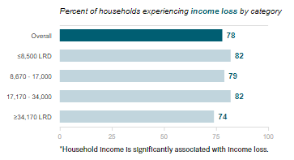
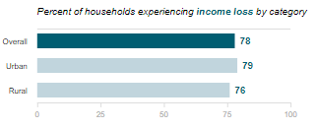
Are people experiencing income loss?
More than three-quarters of respondents reported losing some or all of their income since the start of the pandemic (78%), on par with the average in the Western Region (77%).
Data Breakdown:
The government, in partnership with international agencies, has been supporting some of the most vulnerable populations though cash transfers to women and the poor.
Almost one in five respondents reported receiving government support of some kind (17%), a significant increase since August (7%). Women received two times more government support since August (16% vs. 8%). Most of this assistance was in the form of food.
Partnership for Evidence-based Response to COVID-19

Slide 22
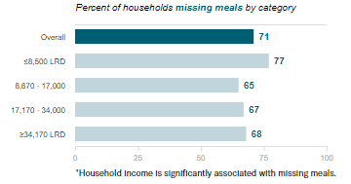
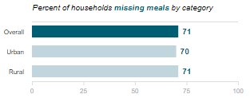
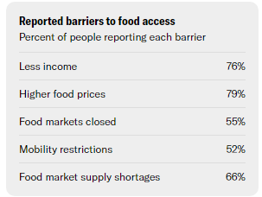
Are people experiencing food insecurity?
Almost two million Liberians (about 32% of the population) are moderately or severely food-insecure. Prices for staple foods were increasing before the pandemic due to inflation and currency depreciation, and COVID-19 has further exacerbated this issue.
Data Breakdown:
More lower-income respondents reported reducing the quantity of meals they usually eat (77%) than higher-income respondents (68%), illustrating the economic disparities in food security.
Partnership for Evidence-based Response to COVID-19

